Slide 1
Welcome to our
KYLDC Community Meeting!
Featured Guest: Anji Davidson,
Jackson Independent, Hybrid Teacher
Host: Kelly Philbeck, KYLDC State Lead/Instructional Specialist

Slide 2
kelly.philbeck@education.ky.gov anjanette.davidson@jacksonind.kyschools.us
Kelly Philbeck
Anji Davidson

Slide 3
Purpose
To build our KYLDC community
To feature in-depth looks into LDC instructional tools and resources
To provide an online platform for continuing professional learning around LDC
To provide updates around LDC at a national and state level

Slide 4
sciencecollection.ldc.org

Slide 5
Module Templates

Slide 6
Modules
Data Analysis
Student Determined Data Analysis
Experimentation
Surf and Turf
What Factors Influence Carbon Dioxide Production and Usage?
Design
Squirmy Science
Catching Sun with
a Donut

Slide 7
Classroom Videos

Slide 8
Lessons/Mini-Tasks

Slide 9
Lessons/Mini-Tasks

Slide 10
sciencecollection.ldc.org

Slide 11
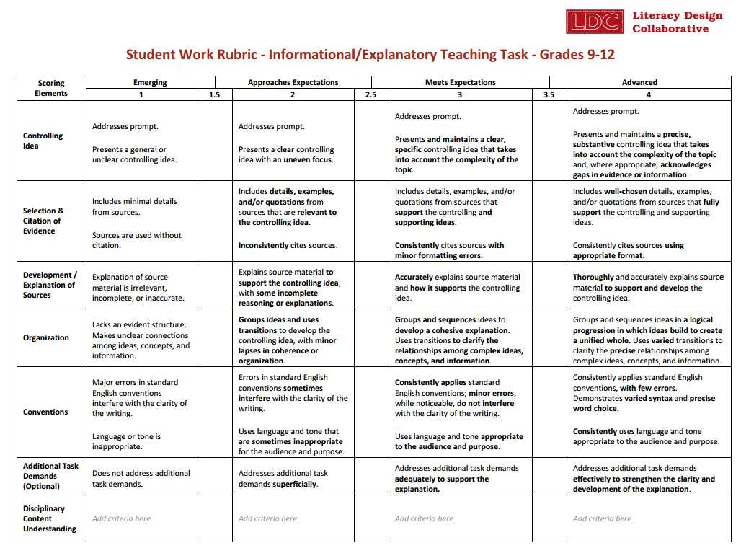
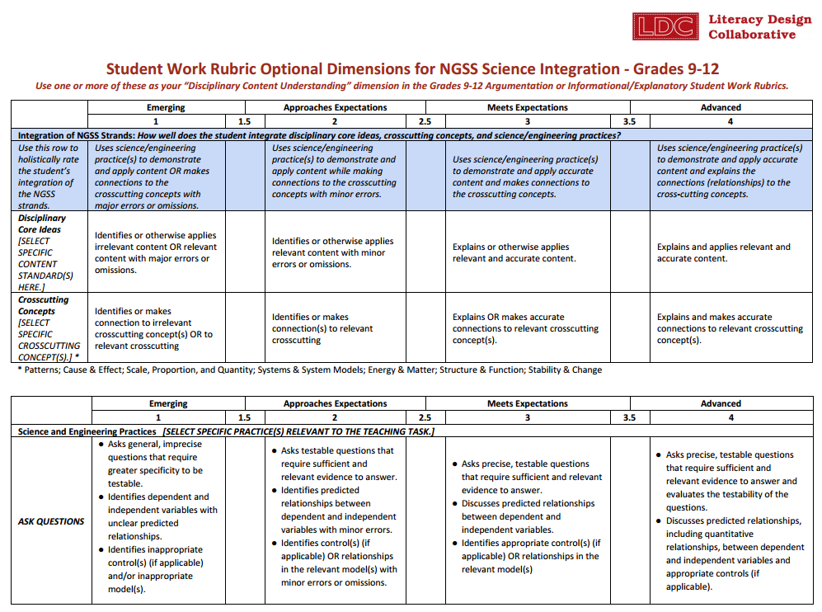
2016-17 Student Work Rubrics from SCALE
The first of the 2016-17 student work rubrics have been released, and they are ready for use! Find them at ldc.org/resources in PDF, Word Doc, and Google Doc formats.

Slide 12
2016-17 Student Work Rubrics from SCALE
Rubrics for Grades 6-8 and 9-12 Argumentation & Informational/Explanatory LDC teaching tasks have been released
All rubrics have been extensively field-tested and revised based on feedback
Rubrics have been found to have a high degree of reliability
New set of rubrics features:
Clearer, more concise language to make it easier to know what to look for and how to score
Separate rubrics for narrower grade ranges (6-8 and 9-12, etc.)
A reduction in number of core scoring dimensions from 7 to 5
New optional scoring dimension for scoring “additional demands”
Flexibility to pick from menus of options when determining which criteria to use for “Disciplinary Content Understanding”
To this end, so far science/NGSS options have been released

Slide 13
New Student Work Rubrics from SCALE

Slide 14
New Student Work Rubrics

Slide 15
Disciplinary Content Understandings

Slide 16
2016-17 Student Work Rubrics from SCALE
What’s Next?
New Argumentation and Informational/Explanatory rubrics for elementary grade ranges
History/Social Studies and other options for “Disciplinary Content Understanding”
Updated “rationale” for the changes to the rubrics
Samples of scored student work with annotated rubrics
Updates to LDC CoreTools to support and enhance flexible use of the 2016-17 student work rubrics
Guided support for using new rubrics
Your feedback!

Slide 17
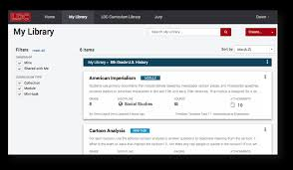
LDC’s Community of Support
www.ldc.org
CoreTools

Slide 18
KYLDC’s Community
Website:
kellyphilbeck.com
Twitter:
@kellyphilbeck
#KYLDC
Facebook:
Kelly R. Philbeck
KYLDC

Slide 19
Upcoming Events
KYLDC Community Meeting featuring our LDC Social Studies Collection: May 9
SREB’s LDC/MDC Networking Conference: July 11-13 Louisville Convention Center
LDC National Jurying Studio: July 14 & 15
www.kellyphilbeck.com (Home/Event Registration)

Slide 20
SREB 4th Annual CCRS Networking Conference
Join LDC in Louisville, KY, this summer!
We are currently accepting proposals for the 2016 Lead and Learn Fellowship for presentations focusing on LDC strategies that help improve how teachers teach and students learn. Click here for more information about the conference and how to submit your proposal!
Proposals are due by April 22nd!

Slide 21
Poll for Future Topics

Slide 22
Thank You for Joining Our
KYLDC Community Meeting!
Featured Guest: Anji Davidson, Jackson Independent, Hybrid Teacher
Host: Kelly Philbeck, KYLDC State Lead/Instructional Specialist
Chat Moderator: Becky Woosley, KDE Effectiveness Coach

