Slide 1
Test Your Tech…
Audio…Test
Sites we will use today…
Log-in to CoreTools @ www.ldc.org

Slide 2
Welcome to our
KYLDC Community Meeting!
Host: Kelly Philbeck, KYLDC State Lead/Instructional Specialist
Facilitators: Rebecca Woosley & Kate Grindon,
KDE Effectiveness Coaches

Slide 3
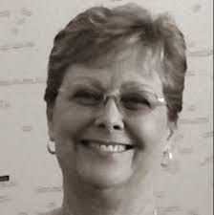
kelly.philbeck@education.ky.gov rebecca.woosley@education.ky.gov kate.grindon@education.ky.gov
Kelly Philbeck Becky Woosley
Kate Grindon

Slide 4
Meeting Links & Materials
www.kellyphilbeck.com
KYLDC Materials
Resource Links
Archived Meetings
PowerPoint
Polls

Slide 5
Purpose
To build our KYLDC community
To feature in-depth looks into LDC instructional tools and resources
To provide an online platform for continuing professional learning around LDC
To provide updates around LDC at a national and state level

Slide 6
Today’s Agenda
CoreTools Updates
Teacher Competencies
New Rubrics Active in CoreTools
Classroom Look-Fors
Upcoming Events

Slide 7
LDC CoreTools Updates

Slide 8
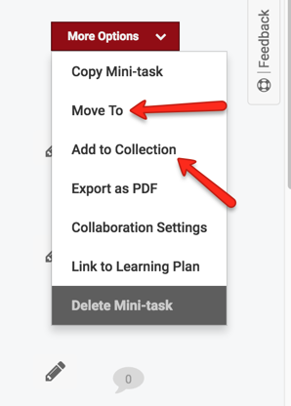
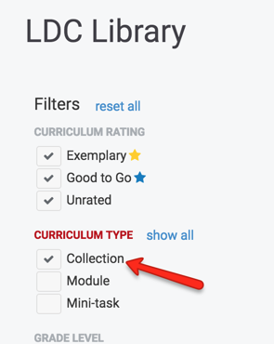
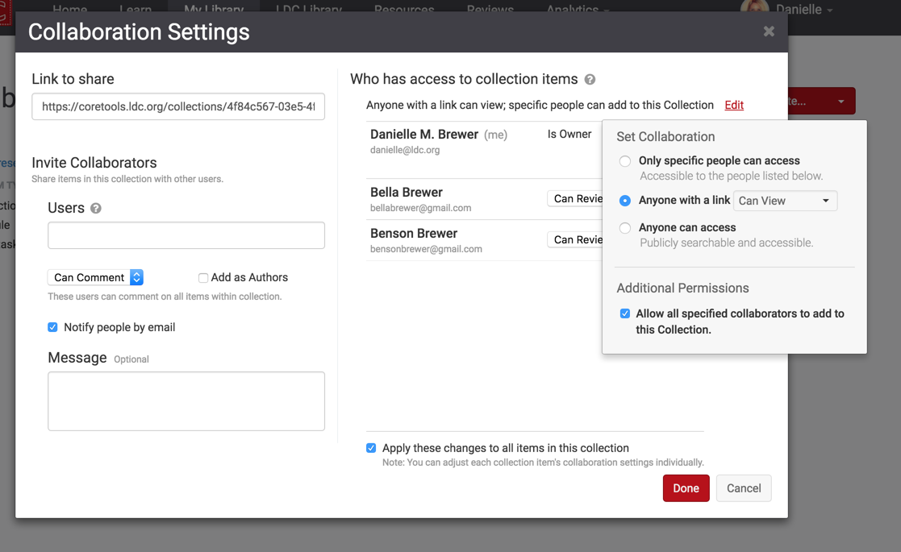
Using Collections
Ways to use Collections in your work:
Search and share already created collections
Create your own collections to share out
Create a collection for your teachers to contribute examples they find
Create a collection for your teachers to share their work
Use collection to set up informal peer reviews with teacher groups
Notes:
For more information about collections visit: https://ldc.org/blog/posts/managing-shared-collections-just-got-whole-lot-easier-%E2%80%9Cadd-collection%E2%80%9D

Slide 9
Elementary Starter Tasks

Slide 11
Short Modules

Slide 13
Other Collections
Kentucky Department of Education
National Writing Project/State Writing Projects
SREB (Southeast Regional Education Board)
Battelle (science)
Facing History (social studies)
Short Modules
Elementary Starter Tasks

Slide 14
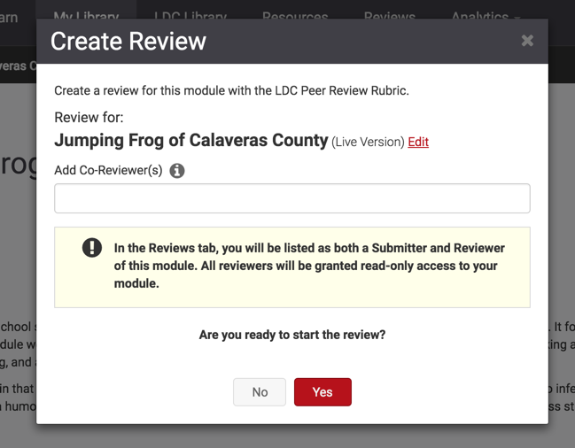
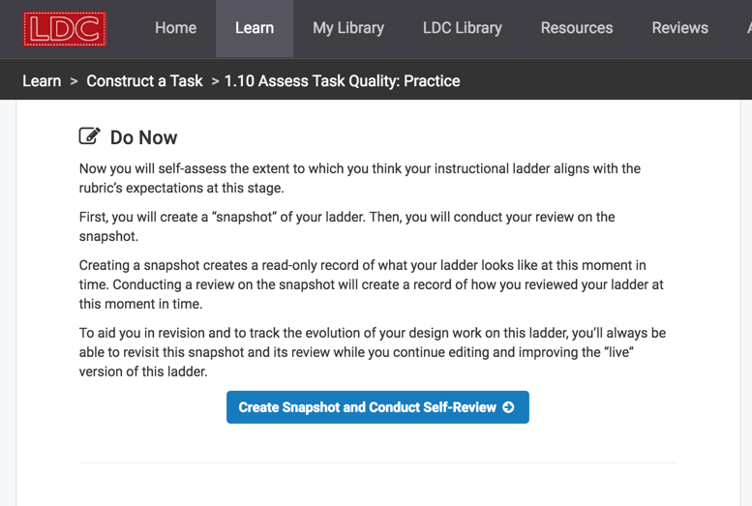
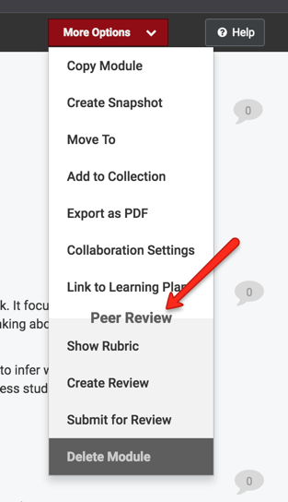
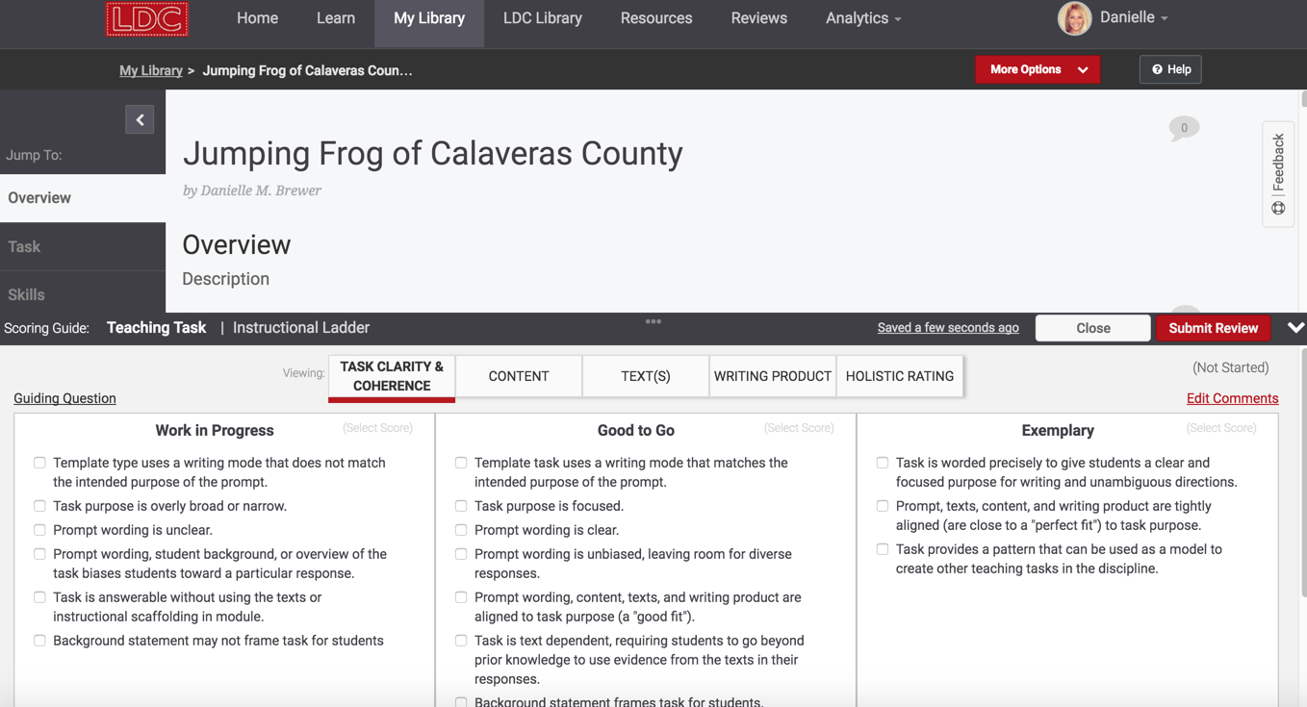
Self/Peer Reviews

Slide 15
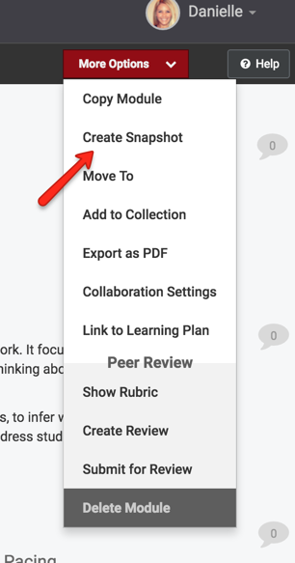
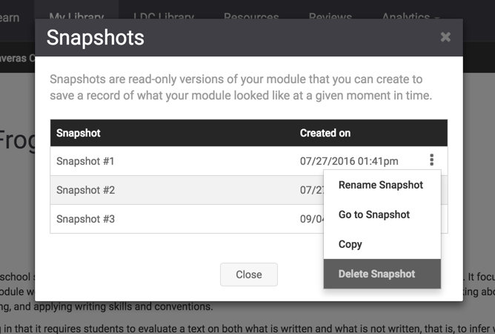
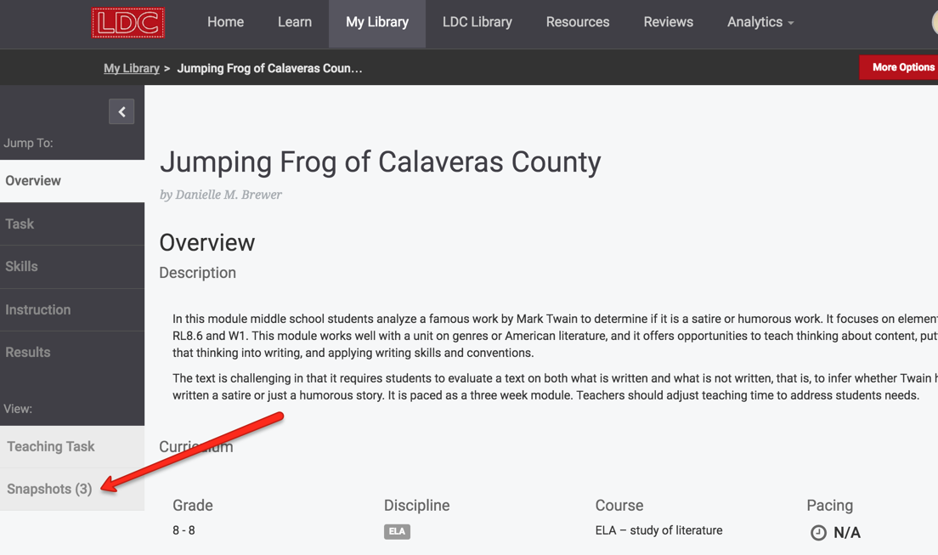
Snapshots
Notes:
To learn more about Snapshots and find a helpful screencast visit: https://ldc.org/learn-more/snapshots
LDC PL Content Block Reference Guide with Snapshots identified: https://docs.google.com/document/d/1tb_w-ExH4ELmKRcCDLbzknLHtxJAUULABhlU8Y4nfM8/edit

Slide 16
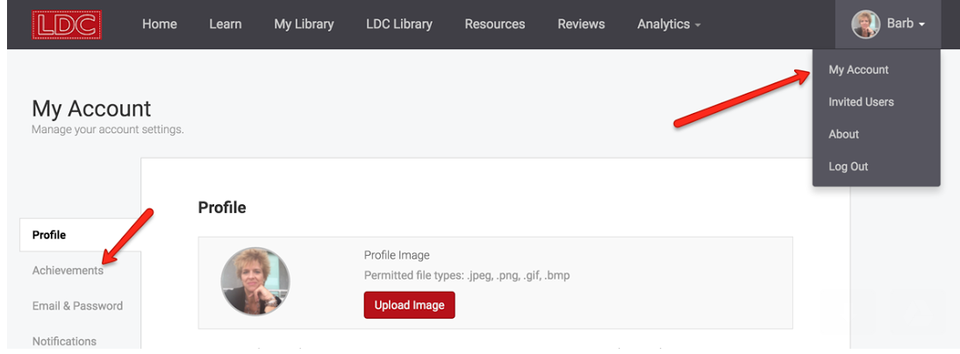
NEW Achievements in CoreTools
Unveiling the new achievement badges and certificates! Unlock them all!
where to find them

Slide 17
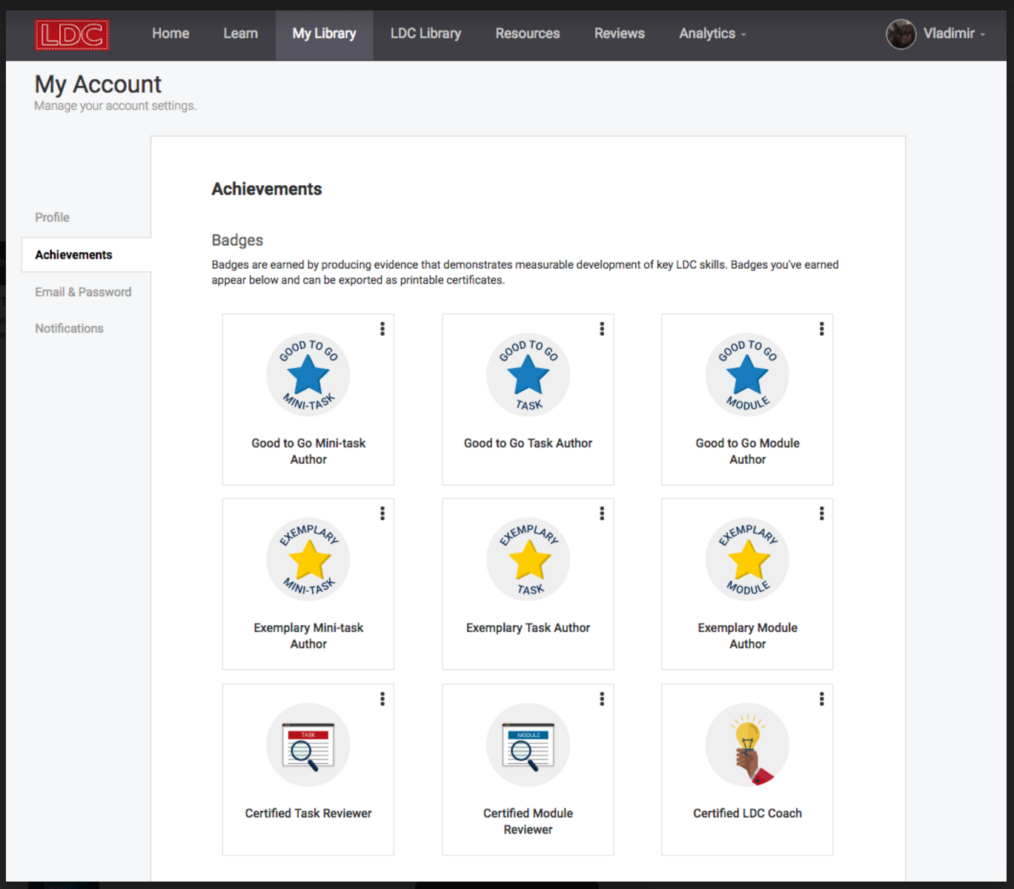

Slide 18
New Student Work Rubrics from SCALE—LIVE in CoreTools!
www.ldc.org/resources

Slide 19
LDC Classroom Look-Fors

Slide 20
Competencies & Practices

Slide 21
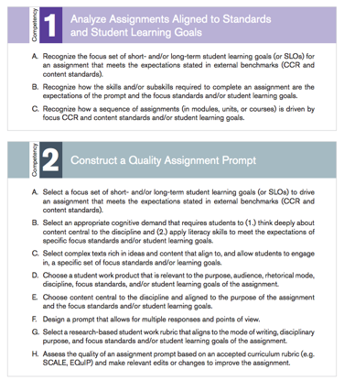
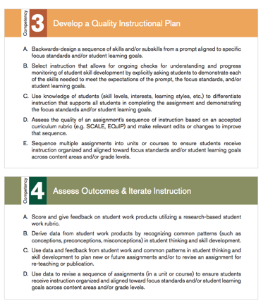
2016: LDC released the 20 LDC Teacher Competencies

Slide 22
LDC Teacher Competency | LDC Indicators | FfT Connections
Competency 1: Analyze Assignments Aligned to Standards and Student Learning Goals | A. Identify short- and/or long-term student learning goals (or SLOs) for an assignment that meets the expectations stated in external benchmarks (CCR and content standards). | 1c: Setting Instructional Outcomes 1e: Designing Coherent Instruction
 | B. Recognize how the skills and/or subskills required to complete an assignment are the expectations of the prompt and the focus standards and/or student learning goals. | 1a: Knowledge of content and structure of discipline 1c: Setting Instructional Outcomes 1e: Designing Coherent Instruction
 | C. Recognize how an assignment or sequence of assignments (in modules, units, or courses) aligns to focus CCR and content standards and/or student learning goals. | 1a: Knowledge of content and structure of discipline, Knowledge of prerequisite relationships 1c: Setting Instructional Outcomes 1e: Designing Coherent Instruction 3c: Engaging Students in Learning

Slide 24
Analyzing Student Work

Slide 25
Monitoring Student Growth

Slide 26
STEPS 3 & 4
Notes:
Refer to pages in packet

Slide 27
Notes:
Refer to pages in packet

Slide 28
KYLDC Featured District

Slide 29
denise.carrell@Jefferson.kyschools.us kate.grindon@education.ky.gov
Denise Carrell
Kate Grindon

Slide 30
LDC Observation Tool Journey - LDC Lessons learned
Denise Carrell JCPS Middle School ELA Specialist
Kate Grindon KDE effectiveness coach

Slide 31
Why does it matter?
SREB study in 7 states (TX, AR, MS, AL, SC, NC, LA)
Teachers who reported “strong admin support” have implemented 4 times as many modules (LDC) and FALs (MDC) as teachers who did not
What counts as “strong admin support”?
Time
Resources
Feedback
Notes:
Kate

Slide 32
Our Main Goals
To develop a tool to help teachers connect LDC to daily/weekly practice
To provide teachers and school leaders with a “look for” support tool
To use information gleaned from walk-throughs/observations to inform our work with teachers
To ensure that backwards planning process begins with content standards supported through the infusion of literacy
To emphasize the power of being transparent with students
Notes:
Denise

Slide 33
Where we started
Literacy Design Collaborative with Danielson Domains Observation Tool
Multiple-page document
Included hard to observe elements
Some repetition of elements
Notes:
Denise

Slide 34
Notes:
Denise

Slide 35
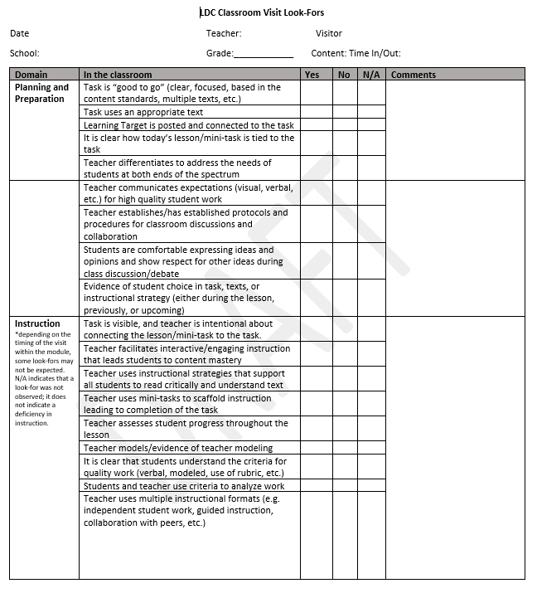
Version 1
Used in ~5 classrooms
Notes:
Kate

Slide 36
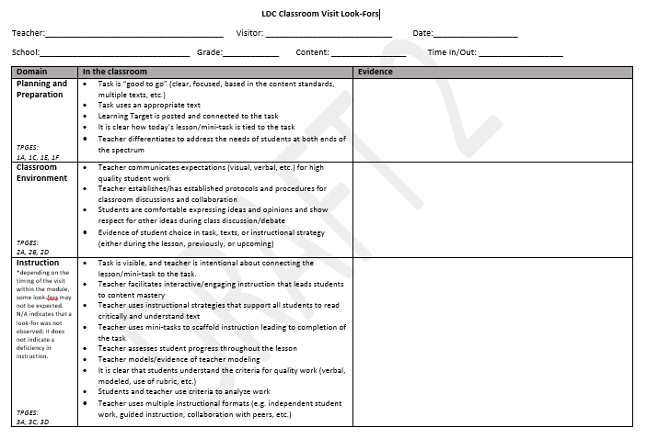
Version 2
Used in 5-10 classrooms
2 middle schools
E/LA, Social Studies contents
Notes:
Kate

Slide 37
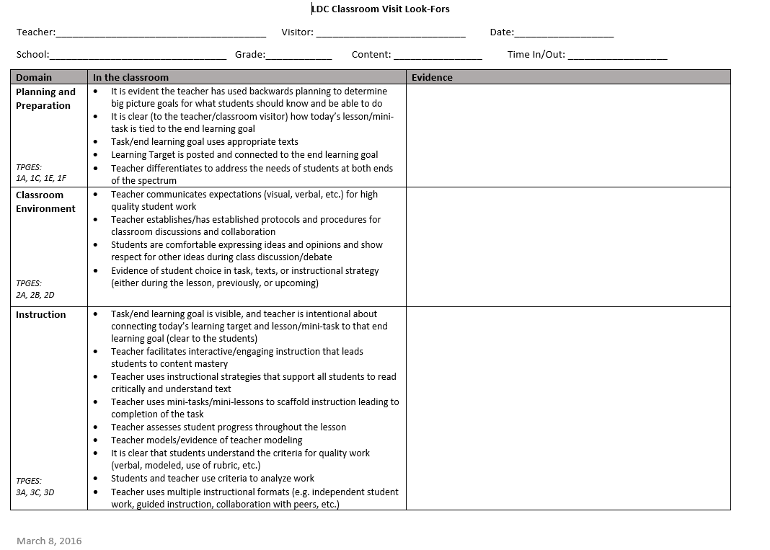
Version 3
Used in ~15 classrooms
All 5 middle schools
E/LA, SS, Science, ECE
Notes:
Kate

Slide 38
Big take-aways
Everything isn’t a module!
Transparency with students is essential
“Macro” v “micro”
Focus must be on content learning (standards)
Instructional best practices work with ALL teachers
Must engage administrators in the creation of the document and in the walk-throughs
Notes:
Denise

Slide 39
District-Wide Effects from Our Work
Transparency of learning for students to connect the daily learning to the end task is HUGE!
Promote systemic backwards planning
Four Instructional Cycles – Professional Development for each cycle focused on backwards planning model
Notes:
Denise

Slide 40
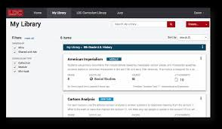
LDC’s Community of Support
www.ldc.org
CoreTools

Slide 41
KYLDC’s Community
Website:
kellyphilbeck.com
Twitter:
@kellyphilbeck
#KYLDC
Facebook:
Kelly R. Philbeck
KYLDC

Slide 42
National Peer Review
NATIONAL PEER REVIEW EVENTS
LDC National Peer Review takes place quarterly; deadlines for submitting modules for the 2016–17 school year are as follows:
Summer 2016: module submissions due by July 29, 2016
Fall 2016: module submissions due by October 28, 2016
Winter 2017: module submissions due by January 27, 2017
Spring 2017: module submissions due by April 28, 2017

Slide 43
Poll for Future Topics

Slide 44
Thank You for Joining Our
KYLDC Community Meeting!
Mark your calendars for December 12, 2016 for our next KYLDC meeting!
Host: Kelly Philbeck, KYLDC State Lead/Instructional Specialist
Facilitators: Becky Woosley, KDE Effectiveness Coach
Kate Grindon, KDE Effectiveness Coach

