Slide 1
Facilitating LDC
Adapted from NSDC Coaches Academy www.nsdc.org

Slide 2
Good to See You!

Slide 3
Norms
Please complete the following three sentence stems…
It would help me today if we all agree to…
It would really be beneficial if we could all just…
It would be best if we could refrain from…
- Share at your table.
- Agree to share out one for each sentence stem.

Slide 4
Outcomes
Outcomes of the 2 Day Session:
Create a shared vision and understanding of LDC as a framework for implementing the instructional shifts and demands of the Common Core
Gain a deeper understanding of coaching and facilitation behaviors and skills essential to the successful implementation of LDC
Learn from each other through the sharing of experiences, strategies, tools and ideas

Slide 5
Sharing of Successes
Reflect on your experiences with LDC and/or your experiences with other teachers implementing LDC
Jot down one success
Table discussions
Share out

Slide 6
What Is Our Role in Creating Change?

Slide 7
The Final Word Protocol
Groups of 3 people
Appoint a time keeper
Read article and choose one ‘most’ significant idea (Have a couple of ‘back up’ quotes ready, too)
Person #1 reads his/her quote and describes why that quote was chosen (in less than 1 minutes)
Continue around the circle, with each person responding to the quote and what the presenter said – to expand, clarify, provide a different look, ask a question (in less than 1 minute each)
Original presenter responds (in less than 1 minute)
Next person becomes presenter
Continue process until all rounds complete
Notes:
Focus on the protocol
5 min minutes to read
5 min per round x 3 rounds = 15 min
Total 20 min

Slide 8
Around the Clock Colleagues
Find a partner for each number on the clock
Record each other’s name on your clock
Fill in all the numbers with a different person’s name
BE SURE YOU BOTH WRITE NAMES ON THE SAME HOUR OF THE CLOCK!
Notes:
5 min (25)
Process for engaging people

Slide 9
Characteristics of Effective Professional Development
Individually reflect on a productive professional development experience.
Discuss why that PD so powerful.
Generate a list of 10 characteristics of effective learning opportunities for adults.
When everyone is done, meet with 2 other teams to share.
Meet with your 3:00 partner.
Notes:
5-10 min to generate
5-10 min to share
20 min total

Slide 10
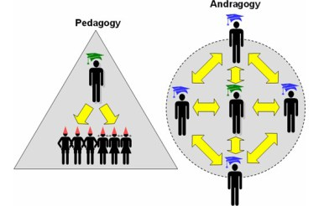
The Andragogical Model vs. Pedagogical Model of Instruction
The Pedagogical Model:
Teacher is the decision maker.
The Andragogic Model:
Adults are independent and responsible for their own actions.
They are often motivated to learn to solve immediate problems they encounter.
They have need to be self-directing.
Notes:
Pedagogy is derived from the Greek word "paid," meaning child plus "agogos," meaning leading. Thus, pedagogy has been defined as the art and science of teaching children. In the pedagogical model, the teacher has full responsibility for making decisions about what will be learned, how it will be learned, when it will be learned, and if the material has been learned. Pedagogy, or teacher-directed instruction as it is commonly known, places the student in a submissive role requiring obedience to the teacher's instructions. It is based on the assumption that learners need to know only what the teacher teaches them. The result is a teaching and learning situation that actively promotes dependency on the instructor (Knowles, 1984).
Up until very recently, the pedagogical model has been applied equally to the teaching of children and adults, and in a sense, is a contradiction in terms. The reason is that as adults mature, they become increasingly independent and responsible for their own actions. They are often motivated to learn by a sincere desire to solve immediate problems in their lives. Additionally, they have an increasing need to be self-directing. In many ways the pedagogical model does not account for such developmental changes on the part of adults, and thus produces tension, resentment, and resistance in individuals (Knowles, 1984

Slide 11
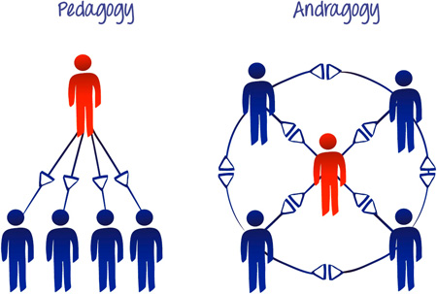
Adult Learning Theory
What do adults want in learning opportunities?
Realistic and important goals
To be self-learners
To see relationship between PD and day-to-day activities
Direct, concrete experiences
Support from peers and reduced fear of judgment
Specific, timely and abundant feedback
Small group activities to apply, analyze, synthesize and evaluate
Honoring of previous experiences, knowledge and interests
Practice to transfer new learning
Notes:
Fly in

Slide 12
Adult Learning
Read Considerations When Working with Adults.
Identify 5 which are your strengths.
Select 5 that you will focus on to improve the quality of your work as a trainer/facilitator.
Notes:
10 min

Slide 13
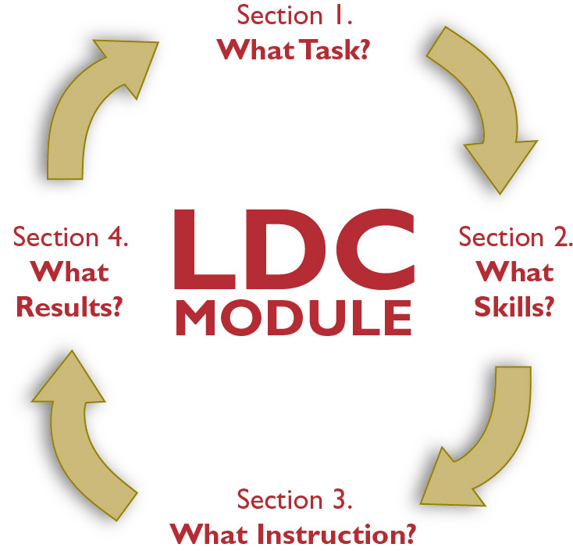
Section 1: What Task?
Rich tasks
Choosing text
LDC provides a context for shared and collaborative responsibility.
LDC provides a context for continuous professional learning.
Notes:
Use Mother to Son as example for each section

Slide 14
Template Task Collection 3.0
Writing Type: Argumentation or Informational/Explanatory
Text Structure: Definition, Description, Analysis, Problem-Solution, etc.

Slide 15
Strong Teaching Tasks
Strong Teaching Tasks are:
Are worthy of 2, 3 or 4 weeks of instruction
Ask students to grapple with important content to the discipline
Target grade specific Common Core literacy standards and content GLEs
Evolve from a rigorous text-dependent question directly related to the content or standard(s)being taught
Provide opportunities to read informational text of appropriate text complexity and content specific to the grade level
Have students working in the most effective mode of discourse/text structure to demonstrate understanding and new knowledge
Involve products written for an authentic audiences
Stay true to the wording of the template task
Important Note:
When looked at cumulatively, strong teaching tasks engage students in a balanced set of rich writing tasks over the course of the year.

Slide 16
Providing Feedback on Teaching Tasks
Use the LDC Jurying Tool and
review the Teaching Task.
Work in groups of 3.
Each person takes a role:
The presenting teacher
The coach
The observer
.

Slide 17
Guiding Teachers in Writing a Strong Teaching Task
Step 1: What is the topic and/or text that will be addressed in this module and what do you want students to learn while studying this topic (enduring understandings)?
Students should understand that there benefits of the British Industrial Revolution, but also that there were costs.

Slide 18
Guiding Teachers in Writing a Strong Teaching Task
Step 2: What reading standard (in addition to #1 and 10) will be targeted/taught through this module?
RH9-10.9 Compare and contrast treatments of the same topic in several primary and secondary sources.

Slide 19
Guiding Teachers in Writing a Strong Teaching Task
Step 3: What content standards will be targeted/taught through this module?
Students will analyze the factors and conditions needed to industrialize and to expand industrial production as well as shifts in economic practices.
Students will examine changes and innovations in energy, technology, communication, and transportation that enabled industrialization.
Students will investigate the social, political, and economic impacts of industrialization…

Slide 20
Guiding Teachers in Writing a Strong Teaching Task
Step 4: What writing standard(s) will be targeted/taught through this module?
WHST9-10.1
Write arguments focused on discipline-specific
Content…
and WHST9-10.9
Draw evidence from informational texts to support
analysis, reflection, and research.

Slide 21
Guiding Teachers in Writing a Strong Teaching Task
Step 5: Considering your topic, ask yourself what text structure would be most conducive to a successful student response (i.e. compare/contrast, define, describe, cause/effect, etc.)?
Original Task 2 Template (Argumentation/Analysis): [Insert question] After reading ________ (literature or informational texts), write a/an ________ (essay or substitute) that addresses the question and support your
position with evidence from the text(s). L2 Be sure to acknowledge competing views. L3 Give examples from past or current events or issues to illustrate and clarify your position.

Slide 22
Guiding Teachers in Writing a Strong Teaching Task
Step 6: Decide if you will begin the teaching task with a question. Decide which (if any) demands to include in the teaching task.
Were the achievements and growth of the Industrial Revolution Era worth the cost to society? After reading secondary and primary sources pertaining to the British Industrial Revolution, write an argumentation essay that addresses the question and support your position with evidence from the texts. Be sure to acknowledge competing views.

Slide 23
Key Talking Points, Protocols and Processes when Discussing…
Overview
Text Choice
Background
Extension

Slide 24
Active Listening Adapted from NSDC Coaches Academy www.nsdc.org

Slide 25
Falling Awake by Dave Ellis
Break into groups of 5.
Jigsaw the discussion of Chapter 7:
P. 170 to the top of 173
p. 173 to 175
p. 176 to the top of 178
p. 178 to the top of 182
p. 182 to 185
Share the key elements of your section with the rest of your team.
Notes:
Handout 13 – Falling Awake, Chapter 7 – next 3 slides

Slide 26
Respond to Listen Fully
Ideas I got about listening…
Habits I want to break…
Habits I want to make…
Opportunities for my work as an LDC Trainer…
Notes:
Handout 14 – Listen Fully Graphic Organizer

Slide 27
Look at Section 2: What Skills?
UbD
Grade level CCSS reading, writing, speaking and listening skills
Preparing Cluster
Reading Cluster
Transition to Writing
Writing Cluster
LDC provides a context for shared and collaborative responsibility.
LDC provides a context for continuous professional learning.

Slide 28
Cluster 1: Preparing for the Task
*Task Engagement
*Task Analysis
*Rubric Analysis
Cluster 2: The Reading Process
*Text Selection (if using “After researching…..”)
*Active Reading - (add Your Targeted ELL Skill)
* Active Reading, Note Taking and Essential Vocabulary *Academic Integrity
Cluster 3: Transition to Writing
*Bridging Conversation
Cluster 4: Writing Process
*Claim or Thesis Statement
*Planning
*Developing
*Revision
*Editing
*Completion
Sample LDC Skill Cluster Ladder
1-2 Days
3-7 Days
3-7 Days
1-2 Days
Notes:
Make this into a handout

Slide 29
Each skill cluster is broken into specific skills which helps guides teacher in planning instruction.
Skills are from ELA and content specific grade level standards.
Definition (ability to….) creates instructional clarity.
Specific skills guide teacher in planning instruction..
Skill Cluster 2: Reading Process (Grade 8)
Skill | Definition
CLOSE ACTIVE READING | Ability to: read purposefully; cite and record textual evidence that most strongly supports an analysis of what the text says explicitly as well as inferences drawn from the text (RI8.1); determine a central idea of a text and analyze its development over the course of the text including the relationship to supporting ideas(RI8.2); provide an objective summary of the text (RI8.2)

Slide 30
What Skills Do Students Need?
Consider the following to determine skills to target:
Demands of the task itself
Expectations of your grade level standards
Strengths and needs of the students

Slide 31
Grade Specific Definitions
How would you rewrite the following generic skill definition into one which pinpoints your grade level expectations?
POST-READING > ACADEMIC INTEGRITY:
Ability to use and credit sources appropriately.
5th - Ability to paraphrase information and provide a list of sources.
6th - Ability to quote and paraphrase and provide basic bibliographic information.
7th – Ability to quote or paraphrase and follow a standard format for citation.

Slide 32
Sample Prototype Skills Ladder
Work in groups of 3.
How could these skills be defined to better reflect grade specific standards?
Redefine at least 3 at your grade level.
Notes:
Groups of 3 – discuss task
One then acts as coach
One as teacher
One observes and offers feedback

Slide 33
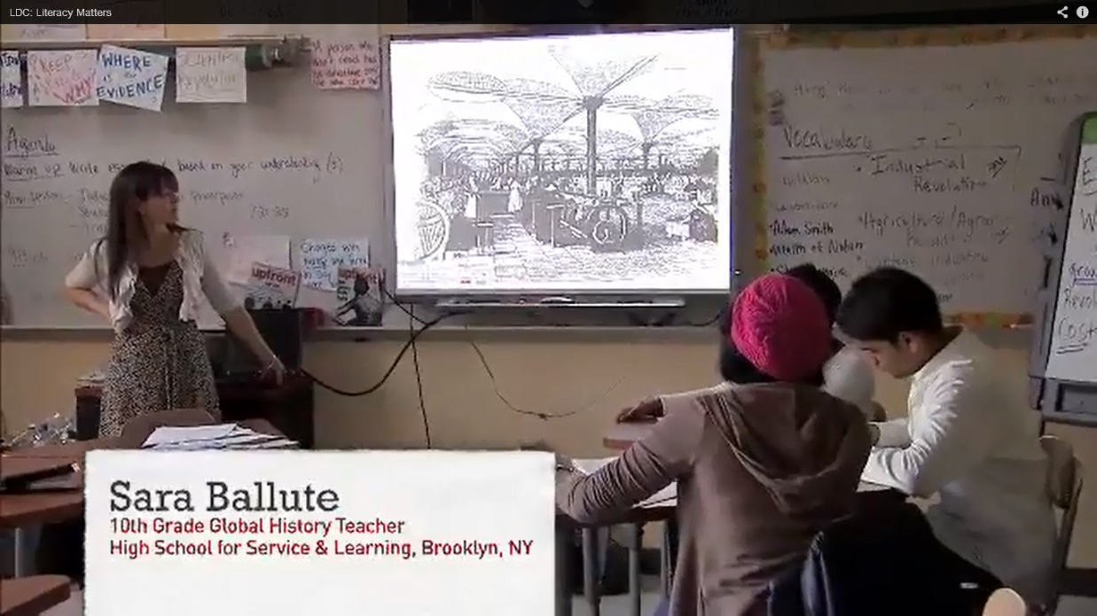
A Look at LDC in the Classroom – Mini Tasks
What do you notice about Section 2 – What Skills
and
Section 3- What Instruction ?
Literacy Matters http://www.youtube.com/watch?v=O5EnOVjRPGI
Notes:
Video Clip – lens of teacher and students
9.5 minutes --- Brooklyn New York

Slide 34
Let’s Build a Mini-Task
Skill and Definition
Product and Prompt
Scoring
Instructional Strategies
Pacing

Slide 35
Skill and Definition:
Annotating – Ability to cite strong and thorough explicit and inferential evidence from authoritative print sources (RI9-10.1, W9-10.8)
Product and Prompt
Prompt – Read carefully and annotate the text using the annotation key, identifying strong evidence which supports the author’s claim
Product – Annotations on the text
Scoring
Meets expectations if:
At least 1 explicit detail supporting the author’s claim is underlined in each section
At least 1 inferential detail supporting the author’s claim is noted in the margin of each section

Slide 36
Instructional Strategies
Annotation Key is introduced.
Teacher reads, thinks aloud and models annotation of first paragraph.
Partners read and discuss second paragraph.
Partners agree on (and draw a box around) one explicit piece of evidence to support the author’s claim. Share out.
Partners agree on one inferential piece of evidence to support the author’s claim. Share out.
Partners continue with next paragraph…
Pacing
30 minutes

Slide 37
Sample Mini Task
Work in groups of 3.
Use the LDC Jurying Tool and
review the Mini Task.
Each person takes a role:
The presenting teacher
LDC Facilitator
Observer
Notes:
Groups of 3 – discuss task
One then acts as coach
One as teacher
One observes and offers feedback

Slide 38
Give 1 - Get 1 Key Talking Points, Protocols and Processes When Discussing: - Section 2 - Section 3 -CoreTools

Slide 39
Effective Communication
Active listening
Building trust and rapport
Pausing
Paraphrasing
Probing and clarifying
Assuming positive intent
Questioning
Notes:
3 min intro

Slide 40
Active Listening
When we listen with our full attention and truly honor a speaker’s views and experience, relationships are deepened and individuals profoundly changed.

Slide 41
Trust in Schools Bryk and Schneider (Education Leadership 2003)
In schools with low levels of relational trust, there is a 1 in 7 chance of showing gains in student learning.
In schools with high levels of relational trust, there is a 1 in 2 chance of showing gains in student learning.
Notes:
Fly in
5 min intro trust and paraphrase

Slide 42
Behaviors to Foster Trust
Talk straight
Demonstrate respect
Create transparency
Right wrongs
Show loyalty
Deliver results
Extend trust
Adapted from Speed of Trust
by Stephen Covey
Confront reality
Clarify expectations
Practice accountability
Listen first
Keep commitments

Slide 43
Trust Traps
Making assumptions
Breaking promises
Covering yourself
Spreading rumors
By-passing people
Being too “All about ME”

Slide 44
Pausing
Mary Budd Rowe’s “Wait Time” research:
Takes average learner 3 to 5 seconds to process higher level thoughts
Typical response is less than one second!
Model thinking before answering and before asking additional questions
Become comfortable with wait time in groups
Use thoughtfulness in all interactions
Value the importance of silence
Practice deep listening
Notes:
Fly in

Slide 45
Paraphrasing
Acknowledging and Clarifying
Summarizing and Organizing
Shifting Level of Logic
Adapted from the Center for Cognitive Coaching and Bob Garmston

Slide 46
Acknowledge and Clarify
You’re thinking that…
So, you’re wondering if…
You’re frustrated because…

Slide 47
Summarize and Organize
So, there are three issues…
So, you’re ready to move on to…
First, you’re going to… then you will…
On the one hand… and on the other hand…

Slide 48
Shift Level of Logic (up or down)
Goals, values, beliefs, assumptions, concepts:
So, a strong belief you hold is…
An assumption you are operating from is…
A goal for you is…
So, your understanding of… is…
Notes:
Shift down to a more specific level
Or
Shift up to a more general term/category and off specifics

Slide 49
Paraphrasing Practice
Acknowledge
Summarize and organize
Shift the level of logic
Meet with your 7:00 partner.

Slide 50
Acknowledge and Clarify
You’re thinking that…
So, you’re wondering if…
You’re frustrated because…
Summarize and Organize
So, there are three issues…
So, you’re ready to move on to…
First, you’re going to… then you will…
On the one hand… and on the other hand…
Shift Level of Logic
So, a strong belief you hold is…
An assumption you are operating from is…
A goal for you is…
So, your understanding of… is…

Slide 51
A Question Can Be More Powerful than an Answer
“He explained to me with great insistence that every question possessed a power that did not lie in the answer.” ― Elie Wiesel, Night

Slide 52
Questioning Guidelines
Avoid yes/no questions
Eliminate “Why”
Use open ended questions
Use plural nouns
Delete judgment words, negative assumptions and embedded advice
Use introductory phrases (positive presuppositions)
Use exploratory language (i.e. “If…”)
Listen carefully before asking a question
Notes:
5 min intro questioning

Slide 53
Positive Presuppositions
Non-Examples
Examples
Did you look at the template tasks?
Do you know what your students need?
Are you planning to assess student learning in this mini-lesson?
As you examined the various template tasks, what did you consider in making your decision?
When thinking about students’ needs, what skills do you know you need to teach?
While monitoring student learning during the implementation of the module, what will be some indicators of success?
Notes:
Fly in

Slide 54
Positive Presuppositions Practice
Work with your 11:00 colleague to revise a few pieces of feedback using a positive presupposition.
Notes:
10 min

Slide 55
SCALE Training Material

Slide 56
Use the LDC Rubric to Make Instructional Decisions

Slide 57
Give 1 - Get 1 Key Talking Points, Protocols and Processes When Discussing: - Section 4

Slide 58
Effective Feedback

Slide 59
Giving Feedback
Writing effective feedback is vital to the EQuIP Quality Review Process.
Four qualities of effective feedback:
Criteria-based
Evidence Cited
Improvement Suggested
Clarity Provided
Notes:
Criteria-based: Written comments are based on the criteria used for review in each dimension. No extraneous or personal comments are included.
Evidence Cited: Written comments suggest that the reviewer looked for evidence in the lesson or unit that address each criterion of a given dimension. Examples are provided that cite where and how the criteria are met or not met.
Improvement Suggested: When improvements are identified to meet criteria or strengthen the lesson or unit, specific information is provided about how and where such improvement should be added to the material.
Clarity Provided: Written comment are constructed in a manner keeping with basic grammar, spelling, sentence structure and conventions.

Slide 60
Giving Feedback
Effective Feedback
Criteria-based: Written comments are based on the criteria used for review in each dimension. No extraneous or personal comments are included.
Evidence Cited: Written comments suggest that the reviewer looked for evidence in the lesson or unit that address each criterion of a given dimension. Examples are provided that cite where and how the criteria are met or not met.
Improvement Suggested: When improvements are identified to meet criteria or strengthen the lesson or unit, specific information is provided about how and where such improvement should be added to the material.
Clarity Provided: Written comment are constructed in a manner keeping with basic grammar, spelling, sentence structure and conventions.

Slide 61
Remember…
Assume positive intent!
It is easier to review someone’s module than it is to create one!
There is a real person on the receiving end of the feedback.
The goal is to help the developer move forward in the creation of a well-developed, intentional instructional plan.
Keep in Mind…

Slide 62
Things to Avoid…
Subjective phrasing
Being too negative
Being too positive
Generalities
Harsh wording
Authoritative phrasing

Slide 63
Helpful Phrases…
Wondering about…
Could you possibly…
Would it work if…
__________ might be an option…
Have you considered….
Thinking about _______, would it be beneficial to consider…

Slide 64
Feedback on the Feedback
Is this feedback criteria-based?
Was evidence cited?
Was there an improvement suggested?
Is clarity provided?

Slide 65
Is It Effective Feedback?
Opening question calls for argument, and conflicts with later call to analyze
effectiveness. Wording may also be excessive.

Slide 66
Is It Effective Feedback?
This task tries for two great possibilities, but the current combination may not work. The opening question aims for the enduring argument about whether and how the US should intervene to defend human rights in other countries--but may not fit an informational template and may not be answerable from the assigned texts. The rest of the task asks students to analyze Roosevelt's effectiveness in her speech--which will not provide an answer to the question about policing the world. To move to good-to-go, consider simply removing the question, which is permitted with Template Task Collection 2.0. To move to exemplary, consider revising the prompt to ask students to analyze Roosevelt's argument for which rights should be universal--and consider adding either texts or a research step that allows students to engage the counterarguments made by critics of the Declaration.

Slide 67
Is It Effective Feedback?
Love the task prompt and text selection! Interesting topic! Great job on the skills ladder! Solid but room for improvement on scaffolding the reading.

Slide 68
Is It Effective Feedback?
The lab report is appropriate, and students read and examine scientific writing; however, the instruction for learning to write a lab report is not included.

Slide 69
Is It Effective Feedback?
In themselves, the texts are superb. The weakness here is that they may not give the right background to answer the task. The main solution here may be revising the task wording to be a better fit with what the texts actually include. Depending on the final wording, students may (or may not) need some additional sources to understand
the alternatives to Roosevelt's position. (The plan to have students both read and hear the speech is really interesting: it will be great to see how you plan to use each to contribute to students' deeper understanding.)

Slide 70
Is It Effective Feedback?
Task needs revision. The "enduring legacy" portion is not supported by the readings or instructions--and it isn't needed. Task will work if it is solely about
Proclamation and its military impact. However, if it's about that, it may not be argumentation. Consider an informational task? And consider making it a reading rather than researching, since the texts are provided. Maybe around the question
"How was the Emancipation Proclamation a war strategy?" With this sort of editing, it
can be exemplary!

Slide 71
Is It Effective Feedback?
This is an interesting topic that is potentially a very good introduction to major concepts within the biological science. Of primary concern is that the prompt is phrased as moral/personal values question, rather than a scientific one.

Slide 72
Share Your Thinking…re Y
What are your take-aways from this discussion?

Slide 73
Making Meetings / Professional Development Sessions Work
Building agendas
Establishing norms
Determining roles
Facilitating the session
Assessing progress / Reflecting

Slide 74
Key Elements of an Agenda
Topic
Responsible Person / Roles
Desired Outcome(s)
Timeline
Participant Involvement (IDA)
Information Item
Discussion / Dialogue
Action Item

Slide 75
Considerations about Norms
Create as a team.
Review often.
Revise as needed.
Post in meeting room.
Agree to address violations.
Use to build a community of productivity.
Trust the wisdom of the group to create and use norms wisely.

Slide 76
Facilitating the Meeting/Session
Start on time
Review norms and the agenda
Ice Breakers if needed
Conduct one piece of business/topic at a time
Give others a chance to talk/process/develop
Be transparent
Summarize / Wrap up
Clearly articulate follow-up actions and responsibilities/Exit Slip
End on time

Slide 77
Ice Breakers, Regrouping Activities and/or Connecting Conversations
Why am I here?
Paired introductions
Wonderings on index cards
Two truths and a lie
Hands up / Stand up
Brain Breaks

Slide 78
Assessing Progress
Exit Slips
Team Effectiveness Inventory/Survey
Using Data
“Bring Backs”

