Slide 1
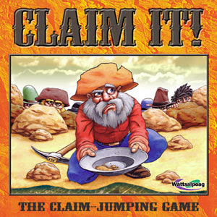
What is a Claim?
A Resource for Use with CRWP Mini-Units and Materials
Jean Wolph
NWP College-Ready Writers Program

Slide 2
CLAIM = A position that can be argued. Strong claims are compelling, debatable and defensible.
Because it’s not a fact.
Can be supported with recent reliable evidence
What is the difference between a claim and a fact?
Evokes interest
Notes:
A handout with more information about claims is available at the Purdue University Online Writing Lab (OWL)
https://owl.english.purdue.edu/owl/resource/588/01/.

Slide 3
Strong claims are compelling, debatable and defensible.
Other Key Characteristics of a Strong Claim:
Identifies the writer’s stance (position)
Is clear and specific (shows the direction of the writer’s thinking)
May use an “umbrella” term that relates to the major points to be made instead of listing all of your evidence
Avoids terms such as “I think” or “I feel”

Slide 4
3 Major Types of CLAIMS | Sample Key Words | Example
FACT (writer is trying to prove something is true) | IS or IS NOT ARE or ARE NOT | Fast Food is unhealthy.
VALUE (requires writer to share or establish criteria) | BETTER/BEST, MORE/LESS, WORSE/WORST --IER or IEST words | Tacos are a healthier choice than hamburgers.
POLICY (writer is trying to change the way things are) | SHOULD/SHOULD NOT | Schools should serve healthier foods.
Notes:
These are not the only types of claims, but are ones that seem to be the easiest for students to work with. Others include cause-effect (writer tries to prove a relationship, answering questions such as “What caused X? What are the effects?) and definition (“What is X? How should we define it?). Problem-Solution is essentially the same as an argument of policy.

Slide 5
Are These Good Claims?
In most states,
teens can drive
at 16.
Kentucky should raise the driving age to 18.
No! This is a statement of fact.
Yes! This is a compelling, debatable, defensible claim.

Slide 6
Making Claims STRONGER
Instead of… | Try…
I think Reality TV is good. Why? We can’t argue against this statement. It is a fact that you like it. | The popularity of Reality TV proves that it meets the audience’s needs.
Reality TV is fake. Why? This is a common complaint and flunks the “compelling” requirement. So what? | Because Reality TV is fake, its lessons are not always “real.” We should therefore limit children’s exposure to it.
You won’t catch me watching Reality TV because of stereotyping. Why? Great angle, but so what? Go beyond yourself to make this debatable! | Viewers should avoid Reality TV because it promotes stereotyping.

Slide 7
The strongest claims are often nuanced.
Nuanced claims are more complex.
They may acknowledge other perspectives:
Although driving has been considered a “rite of passage,” recent studies challenge the notion that age alone is a reliable measure of driving readiness.

Slide 8
The strongest claims are often nuanced.
Nuanced claims are more complex.
They may limit the claim or set boundaries for its application.
Claim: Drivers’ licenses should not be issued before age 19.
Nuanced Claim: In cases of teens’ persistent truancy or misdemeanor convictions, local communities should delay issuing drivers’ licenses until after graduation or at age 19.

Slide 9
Making Claims STRONGER
In the classroom: Let’s brainstorm a class list of claims for the topic we’re studying.
TIPS for Success:
Test to make sure that each one is a CLAIM (takes a position) rather than just a fact or research finding from an article.
Test to make sure the claim is debatable, defensible, and compelling; specific; other-directed.
Check the list to make sure there are options for a variety of opinions.

Slide 10
Refining Our Claims
Try frames such as these to narrow your focus, acknowledge the opposition, and/or limit the claim:
Because of ______, we should ______.
Because of ______, we should not ______.
Although ________, we should ______.
Although ________, we should not ______.

Slide 11
Making Claims NUANCED
Let’s test our claims and revise, if needed:
Test to see whether we can refine the claim by acknowledging an opposing position and/or limiting the claim to particular situations or audiences.

Slide 12
Argument Highway: A Metaphor

Slide 13
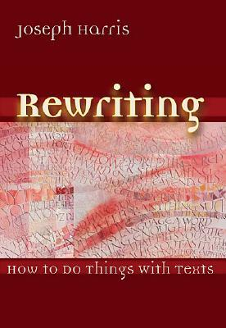
Argument Highway
An instructional metaphor based on
Rewriting: How to Do Things with Texts
by Joseph Harris

Slide 14
The Argument Highway
Argument Highway is a metaphor for the ways good writers use and respond to source material.
The highway represents the ongoing conversations of argument in which people engage every day.
The road is the texts, or source material, upon which these arguments are based.

Slide 15
Argument is students making choices about where they want to go with claims, and how they want to get there – choices of vehicles, roads, and destinations in writing.

Slide 16
Those arguments help them engage with larger, ongoing conversations about all kinds of issues.

Slide 17
Terms to Know: The Road
The road is the texts and source material that provide the basis for argument.

Slide 18
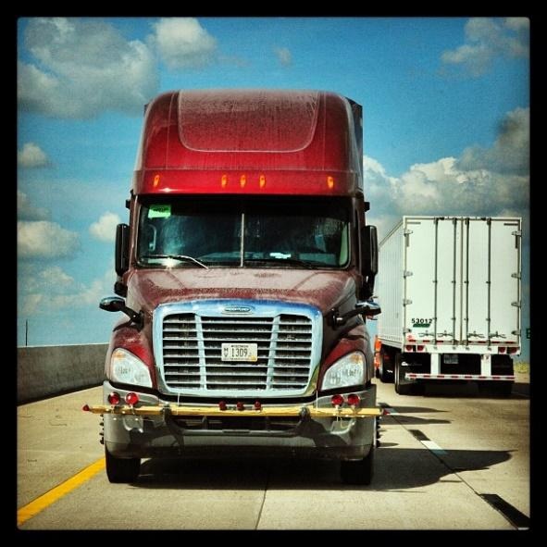
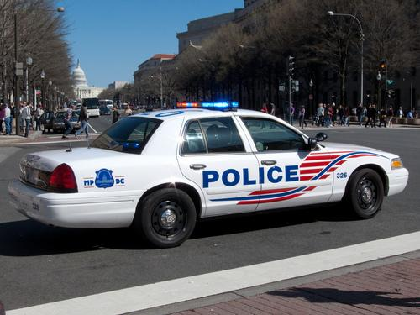
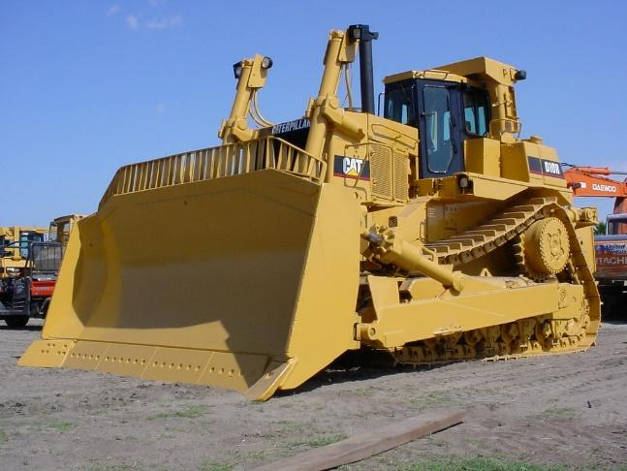
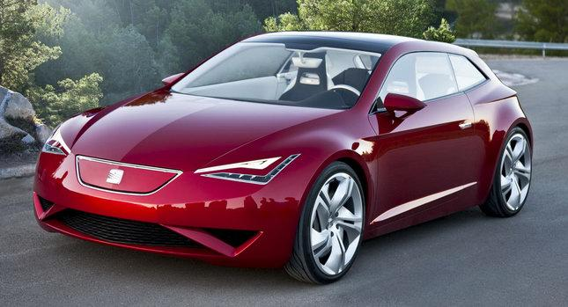
Terms to Know: The Vehicles
The vehicles represent the ways students quote and use source material – the deliberate and specific moves writers make to forward and counter texts.

Slide 19
Terms to Know: The Merge
The merge is the act of what Harris calls “coming to terms” with texts – the close reading, the annotation, the identification of the author’s “project.”

Slide 20
Terms to Know: Road Rage
Road rage is the failure to respectfully acknowledge counterarguments (or the failure to conform to the traditional and respectful rules of argumentation).

Slide 21
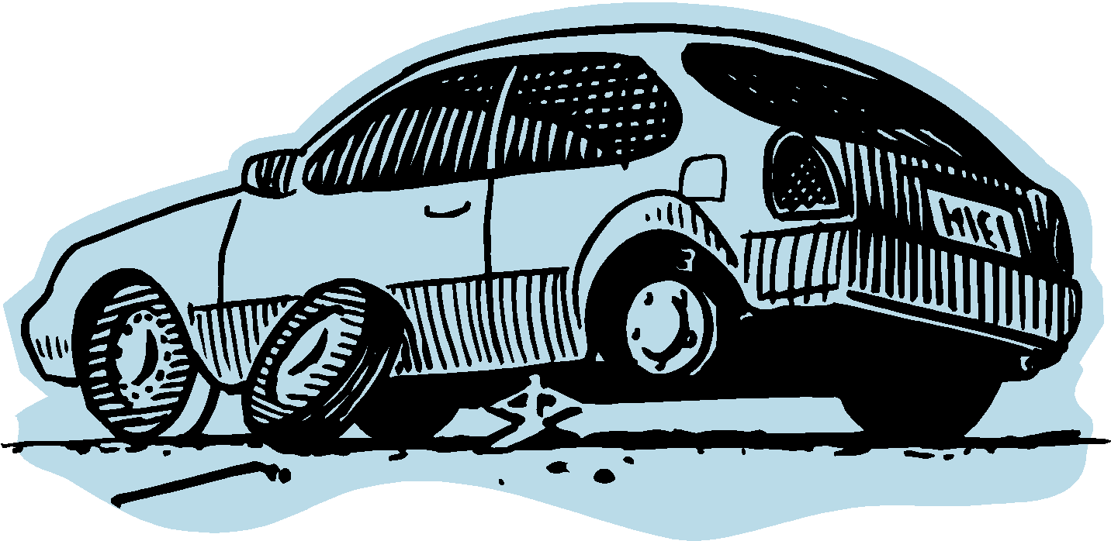
Terms to Know: Flat tire
Avoiding a flat tire is a way to think about students’ mastery of basic writing conventions – skills that give the writer credibility with a wider audience.
Having a flat tire can slow an argument down or even temporarily leave it stranded. The good news is that flat tires can be easily fixed, putting the writer back on the argument highway toward the destination.

Slide 22
The Vehicles (Forwarding Moves)
Extending
Authorizing
Illustrating

Slide 23
The Vehicles (Countering Moves)
“The aim of countering is to open up new lines of inquiry.”
–Harris in Rewriting: How to Do Things with Texts
All forms of Countering
(Arguing the Other Side, Uncovering Values, Dissenting)

Slide 24
Forwarding Moves
Illustrating – When students use specific examples from the text to support what they want to say.
The 18-wheeler carries lots of cargo, representing “material to think about: anecdotes, images, scenarios, data.” (Harris)

Slide 25
What Illustrating Looks Like
Language that captures what an author is saying/doing, as in these templates from Graff and Birkenstein’s They Say I Say:
X argues that
X claims that
X acknowledges that
X emphasizes that
X tells the story of
X reports that
X believes that

Slide 26
Forwarding Moves
Authorizing – When students quote an expert or use the credibility or status of a source to support their claims.

Slide 27
What Authorizing Looks Like
Language that names the particular expertise, credibility, and/or status of an author or source, as in these examples:
Joseph Bauxbaum, a researcher at the Mount Sinai School of Medicine, found …
… , according to Susan Smith, principal of a school which encourages student cell phone use.
A study conducted by the Gulf Coast Center for Law & Policy Center revealed that …

Slide 28
Forwarding Moves
Extending – When students put their own “spin” on terms and ideas they take from other texts.

Slide 29
What Extending Looks Like
Language that reframes the text, adds another layer of interpretation, and/or drives it forward to new conclusions:
So now the latest victims of the Fear of Missing Out are the executives at Facebook themselves, whose dwindling market share is a result of greed and the failure to respond to the demands of a wired generation.

Slide 30
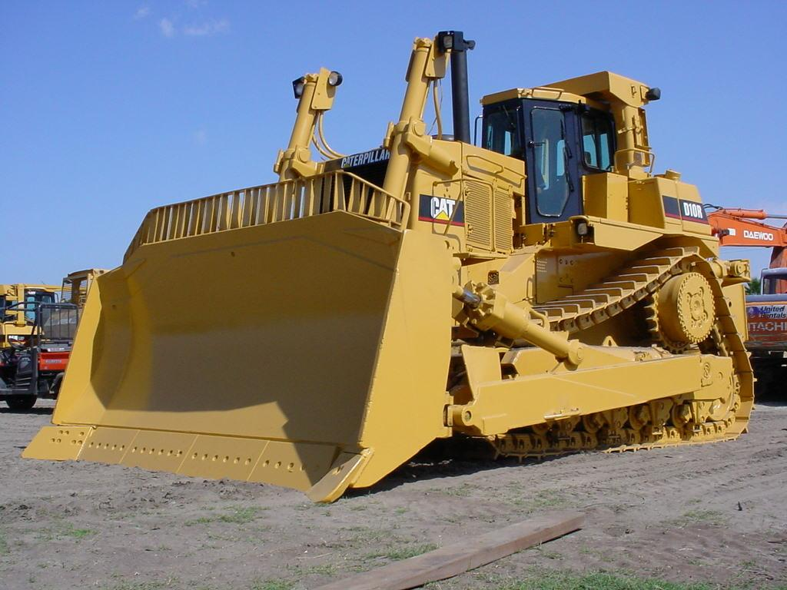
Countering Moves
When students “push back” against the text in some way. They might disagree with it, challenge something it says, or interpret it differently than the author does.

Slide 31
What Countering Looks Like
Language that takes another approach, identifies hidden or absent arguments, or explains where an argument falls short.
What the author fails to consider is … This is true, but …
The same thing can be said for …
The author doesn’t explain why ….
Another way to look at this is …
The study doesn’t explore the connections between …

Slide 32
Works Cited
Harris, Joseph. Rewriting: How to Do Things with Texts. Utah: Utah
State University Press, 2006. Print.
Graff, Gerald and Cathy Birkinstein. They Say I Say: The Moves that
Matter in Academic Writing. 2nd ed. New York: W.W. Norton &
Company, 2009. Print.

Slide 33
Next Steps: Teaching the Moves with a Text Set
1. “Northwestern Players Get Union Vote”
http://espn.go.com/college-football/story/_/id/10677763/northwestern-wildcats-football-players-win-bid-unionize
2. “Of Course Student Athletes are University Employees”
http://www.theatlantic.com/entertainment/archive/2014/04/of-course-student-athletes-are-university-employees/360065/
3. “Northwestern Labor Ruling: Paying College Athletes Should Not Be the Name of the Game” http://www.nydailynews.com/sports/college/bondy-paying-college-players-game-article-1.1736195

Slide 34
Merging
Have students closely read and annotate each text, marking evidence – including and especially those statements:
With which they agree and disagree
That challenge their thinking
That support what they already think
That make them think of new/other ideas

Slide 35
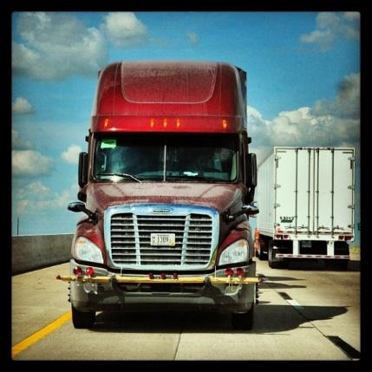
Test drive some vehicles!
Review the purposes of each of the four moves, then have students label their pieces of evidence according to how they might use them in their arguments: to illustrate, authorize, extend, or counter.
Then, using the templates and examples provided, have them practice using and commenting on the source material in various ways.

Slide 36
Questions for Teacher Reflection
How can this metaphor help my students understand academic moves?
How can I provide students with daily practice writing these moves into their arguments?
How will I know that my students are mastering these academic moves?
How will I determine which moves require more instruction?*
*The NWP Using Sources Tool is one resource to help teachers examine the ways students are using sources in their writing.

Slide 37
Extension Ideas & Mini-Lessons
The Argument Highway metaphor lends itself to extensions and mini-lessons that can further help students improve their argument writing. These are introduced on the next few slides.
Red Light/Green Light
Don’t Run Off the Road!
The Cliff of No Support
The Back Road of Non-Credibility

Slide 38
Red Light/Green Light
Use to assess understanding or have students express where they are with claims. In favor of the issue? Green light. Undecided or agree/disagree with exceptions? Yellow light. Completely disagree? Red light.

Slide 39
Don’t run off the road!
Another way of thinking about the “quote sandwich,” teaching students to always explain how source material is relevant to their claims.
Introduce quote
Explain quote

Slide 40
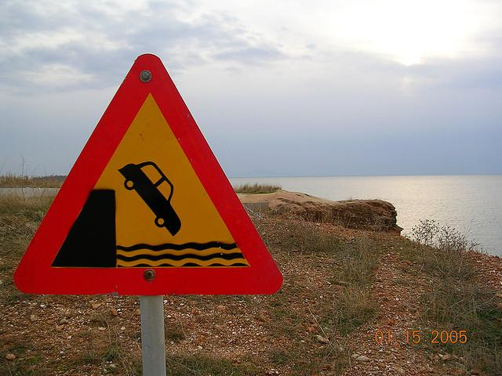
The Cliff of No Support
Encourage students to build their roads of textual support all the way to their argument destinations.

Slide 41
The Back Road of Non-Credibility
This metaphor reminds students to use credible academic sources and to distinguish between the source material and their own writing.

Slide 42
Have an exciting journey on the Argument Highway!

