Slide 1
Welcome!
Please go to www.ldc.org
Login to CoreTools, if you have an account
If you do not have an account…
Go to www.ldc.org
Go to the red button in the top right hand corner
CoreTools Log-In
Enter your name, email, and create a password
Once you’re logged in, complete your Profile information
CoreTools LOG-IN

Slide 2
Building an LDC Jurying Network
Presented by:
Jennifer Watson, SREB, KMGSI Project Director
Barbara Moore, SREB, KMGSI Program Consultant
Kelly Philbeck, KDE, LDC Instructional Specialist

Slide 3
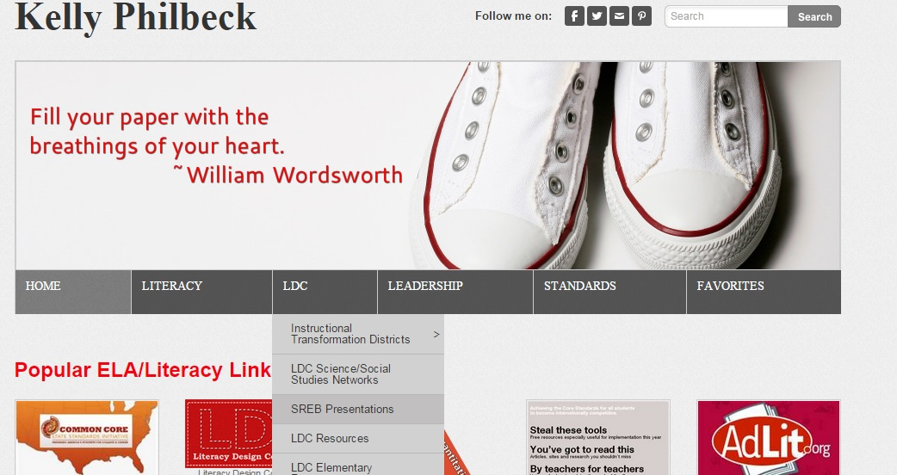
Presentation Materials

Slide 4
Kentucky Middle Grades Schools of Innovation
Created in October, 2011
Partnership with the Kentucky Department of Education
Goal: to ensure that more students in Kentucky leave the middle grades prepared for challenging high school courses and more students leave high school prepared for post-secondary education and/or careers.

Slide 5
KMGSI’s 3-Year Plan
Year One Focus: Literacy Design Collaborative (LDC), guidance/advisory
Year Two Focus: Mathematics Design Collaborative (MDC), career/advisory
Year Three: LDC/MDC Teacher Effectiveness, Success for Every Student

Slide 6
SREB LDC Services
Thirteen days training for LDC initiative
Monthly coaching visits to every member site for duration of project; follow-up coaching letter after every visit
Periodic webinars and teleconferences
Formative reviews of modules with KYDOE specialists and school leads
Recommendations and resources which help embed LDC

Slide 7
Project Successes
During the course of the project, 20 middle schools maintained membership.
Nine high schools participated with their middle school partners for two years.
Middle Schools averaged 3.46% improvement of students proficient or above on state assessments in reading and 3.06% improvement in writing.

Slide 8
KMGSI Sustaining Schools
In 2014-2015, Kentucky Department of Education funded an additional year for 3-year members to establish a leadership model for LDC sustainability.
School teams studied the connections between LDC best practices and indicators for teacher effectiveness, as defined by Kentucky’s effectiveness model (Danielson).
Module jurying is an LDC best practice aligned with effectiveness indicators.

Slide 9
Jurying in the Past
www.inmagine.com

Slide 10
Learning the 2014-2015 Rubric
LDC TEACHING TASK SCORING GUIDE
Category | Work in Progress | Good to Go | Exemplary
GQ1: Does the teaching task, along with texts, content and student product, have a clear and coherent purpose and focus, allow for diverse responses, and require students to respond to texts?
Task Clarity & Coherence Score: | Template type uses a writing mode that does not match the intended purpose of the prompt. Task purpose is overly broad or narrow. Prompt wording is unclear. Prompt wording, student background, or overview of the task biases students toward a particular response. Task is answerable without using the texts or instructional scaffolding in module. Background statement may not frame task for students. | Template task uses a writing mode that matches the intended purpose of the prompt. Task purpose is focused. Prompt wording is clear. Prompt wording is unbiased, leaving room for diverse responses. Prompt wording, content, texts, and student product are aligned to task purpose (a "good fit"). Task is text dependent, requiring students to go beyond prior knowledge to use evidence from the texts in their responses. Background statement frames task for students. | ("Good to Go" characteristics and...) Task is worded precisely to give students a clear and focused purpose for writing and unambiguous directions. Prompt, texts, content, and student product are tightly aligned (are close to a "perfect fit") to task purpose. Task provides a pattern that can be used as a model to create other teaching tasks in the discipline.
GQ2: Does the teaching task build students' content knowledge, enduring understandings, and complex, higher order thinking skills central to the discipline?
Content Score: | Has a weak connection to content central to the discipline. Oversimplifies a topic, OR does not require students to engage in analytic reading and thinking skills. Includes content or skill standards that are not relevant the task | Addresses content central to the discipline and grade level CCSS reading standards, requiring students to build strong content knowledge. Engages students in a range of analytic reading and thinking skills. | ("Good to Go" characteristics and...) Addresses big ideas or enduring understandings central to the discipline. Engages students in complex, higher- order thinking skills specific to the discipline.

Slide 11
Tips for Helpful Feedback
Feedback without specifics is called “praise” or “criticism.”
NOT: “Great task statement ☺”
BUT: “A speech is a product that will allow students to meet multiple standards.”
NOT: “Some skills are not being taught.”
BUT: “What speaking skills will students need to learn before they can deliver an effective speech?”

Slide 12
Tips for Helpful Feedback
PROVIDE FEEDBACK THAT PROMPTS REVISION AND REINFORCES QUALITY
When revisions are needed, suggest a possible approach. Example: “You have modified the template task. Examine other template tasks to see if there is one that better meets your needs.”
Be sure to use specific positive feedback to reinforce well-designed portions of the module. For example, teachers often have effective strategies in the instructional ladder, even if the module design is flawed.

Slide 13
Tips for Helpful Feedback
USE BOTH DIRECTIVES and QUESTIONS for FEEDBACK PROMPTS
Directive: Provide a pacing guide and assessment for this mini-task.
Question: How will you determine if all students have mastered the skill this mini-task is teaching?

Slide 14
Tips for Helpful Feedback
LEARN the LANGUAGE of the LDC JURYING RUBRIC
Spend some time reviewing the rubric so that you will be able to match your concerns or reinforcement statements with concepts that describe a “work in progress,” “good-to-go” or “exemplary module.”
Developing a “co-created” jurying rubric during PLC time can help everyone better understand the meaning behind feedback comments and questions.

Slide 15
Preparing for Formative Jurying
Notes:
7:10

Slide 16
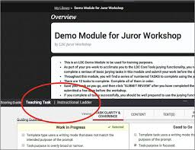
Preparing for Formative Jurying

Slide 17
Directions for Saving Task/Jurying
Go to your CoreTools Account
LDC Curriculum Library Tab
Search for: KMGSI Demo
Click on 3 vertical dots: Copy Module
Sure? Click Copy Module
Click Go to My Copy
Click on the red More Options button
Click on Create Review
Are you ready? Click YES

Slide 18
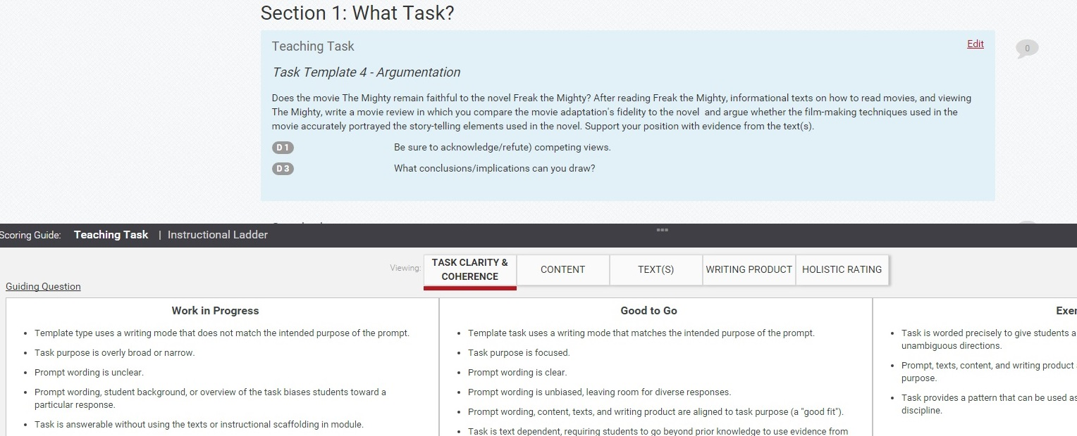
Formative Jurying

Slide 19
Jurying Schedule

Slide 20
Questions & Comments?

Slide 21
Resources
www.ldc.org
LDC CoreTools
Jurying Screencast
https://www.youtube.com/watch?v=3hBx6f4dcnc&index=2&list=PL5q6a8kYJ8L2HK-9G_k3y0jZXkxj3EZtQ

Slide 22
Presentation Materials

Slide 23
Contact Information
Jennifer Watson
jennifer.watson@sreb.org
Barbara Moore
barbara.moore@sreb.org
Kelly Philbeck
kelly.philbeck@education.ky.gov
www.kellyphilbeck.com
Facebook: KYLDC
Twitter: @kellyphilbeck #KYLDC

