Slide 1
Notes:
Before we begin:
Open Plickers website for live view of responses
Open Kelly’s website to show participants
Open LDC CoreTools
Open Gapminder World
Queue all videos on YouTube just in case the embedded videos won’t work. Yikes!
Country Boys
200 countries in 200 years YouTube
Put slips of paper on table for poverty myths on one side of room and poverty facts on the other side
Put Plicker cards on tables
When we go to grade level teams, we need to designate areas they will go to before the day begins.
On the table from the jump:
Highlighters
Progressions
3 Modes document

Slide 2
Using Multi-Media & LDC Mini-Tasks to Improve Student Writing
Kelly Philbeck
Jackie White Rogers
Notes:
This is just up as they enter the room.

Slide 3
Who’s in the house?
Claim a Plicker card
Card has A, B, C, D – Whatever letter is on top when it is scanned, is the letter you are choosing.
You will use this card multiple times throughout the day – hold on to it! ☺
For more information about using Plickers http://www.thepespecialist.com/plickers/
Notes:
4 minutes just to get their card, an explanation of how it works and then the question “Who’s in the house?” and view the live results.

Slide 4
Kelly Philbeck
Current Position:
Instructional Specialist, KDE
State LDC Lead
In a Past Life:
Middle School English Teacher
Literacy Coach
ELA Network Lead
Favorite Books
Of Mice and Men & The Outsiders
Contact Info:
Kelly.philbeck@education.ky.gov
@kellyphilbeck on Twitter
Notes:
2 minutes

Slide 5
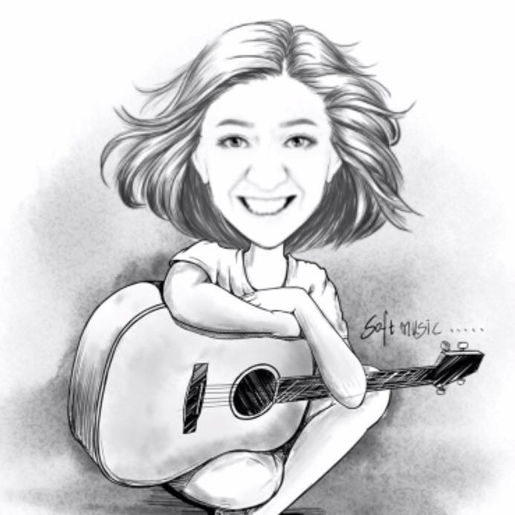
Jackie Rogers
Current Position:
Instructional Specialist, KDE
In a Past Life:
High School English Teacher
Curriculum Specialist
Principal
Favorite Book:
The Poisonwood Bible
Contact Info
Jackie.rogers2@education.ky.gov
@KYWriteRight on Twitter
Notes:
2 minutes

Slide 6
Learning Targets
I can distinguish among the 3 modes of writing and practice effective instructional strategies.
I can use critical literacy to support student engagement through writing and reading connections.
I can use mini-tasks in LDC Core Tools as tools to target students’ literacy skills.
Notes:
5 minutes
Give a broad stroke of the day.
Logistics, stop and ask us questions at any time, set up of the day. Talk about availability of resources.

Slide 7
Writing Standard 3: Narrative
The power and the punch
Notes:
2 minutes
Intro about the modes we will look at individuals and tie all 3 together, which is essential.

Slide 8
PBS Frontline, Country Boys
A David Sutherland Film
Notes:
3:30 minutes video + 5 minutes explanation & writing + 3 minutes discussion = 11:30 minutes (take out discussion) = 8:30
Triad Thinking – just let them watch the video with little prompting. Then when finished, ask them to write a summary statement on one leg of their TRIANGLE. Talk with a thought partner about the video. May share whole group.
Pull up the video on YouTube before the meeting just in case this doesn’t play automatically during the meeting.

Slide 9
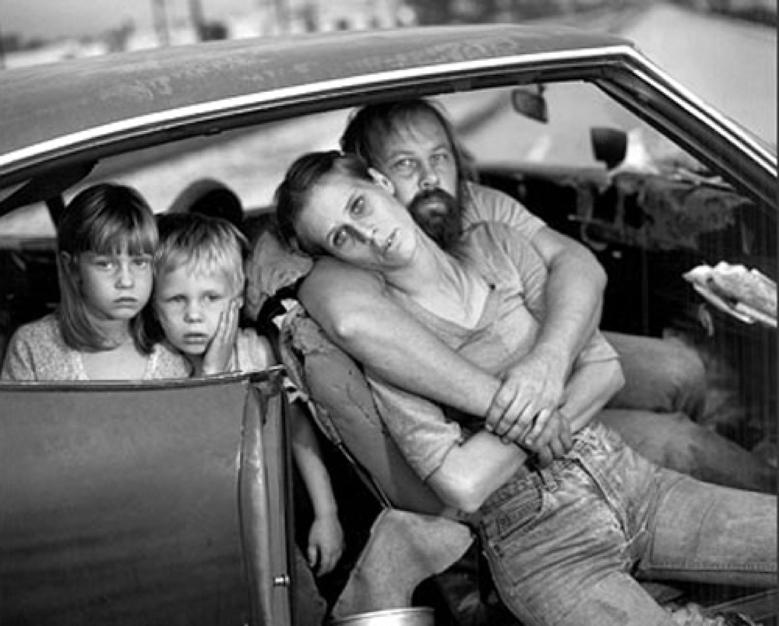
1
Photo credit: Mary Ellen Mark
Notes:
View 4 images x 1 = 4 minutes + discussion with partners 4 minutes, captioning pic 2 minutes, whole group discussion 5 minutes = 15 minutes
Show images on the screen and closely read from there.
An alternative way to use the pictures would be: All 4 photos will be taped to a piece of chart paper with the 4 facing N,E,S,W. Participants will have 2 minutes with each photo, rotating around the table. Talk in pairs or larger groups and then with the whole group. As a group, pick a pic to caption. Share with the whole group.
Talk about the advantages of letting students work in smaller groups first as a way to gain confidence and so everyone is heard.

Slide 10
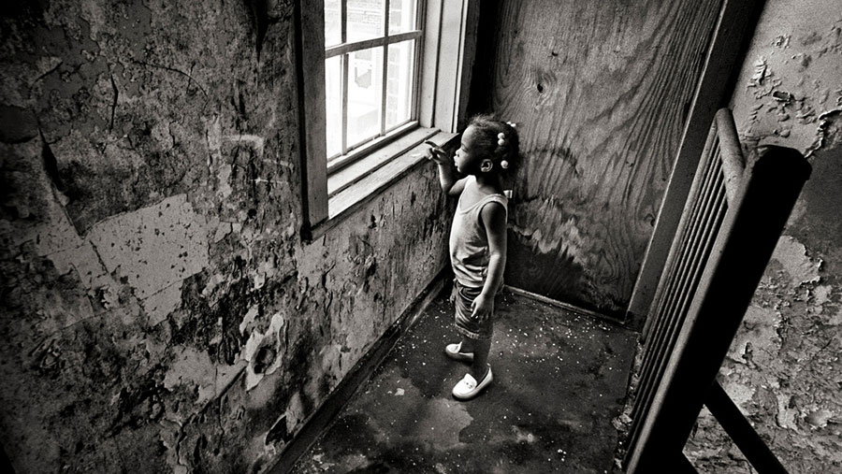
2
Photo credit: Bill Moyers

Slide 11
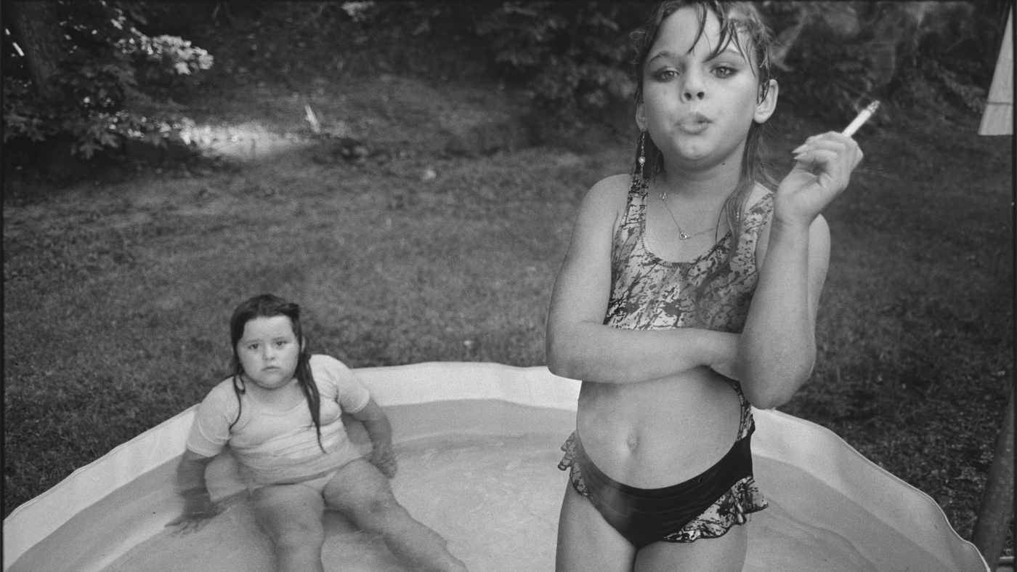
3
Photo credit: Mary Ellen Mark
Notes:
OMG….the article of what happened to her…http://www.npr.org/2015/06/27/417782675/what-happened-to-the-9-year-old-smoking-in-mary-ellen-marks-photo

Slide 12
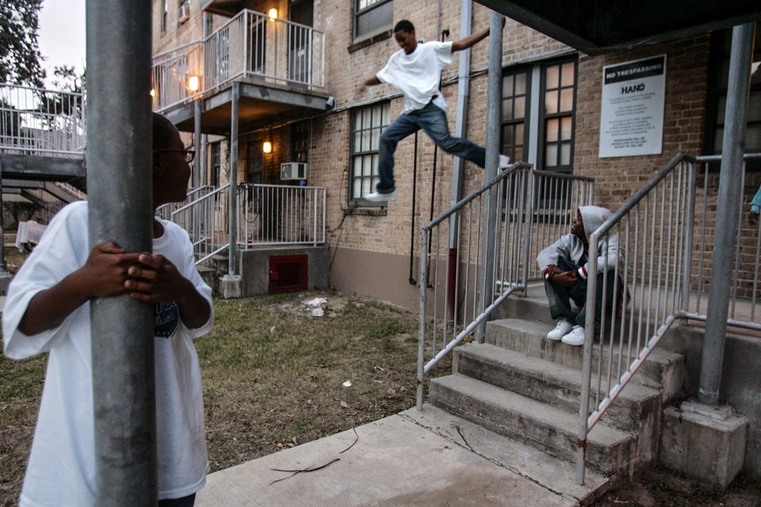
4
Photo credit: Lee Celano
Notes:
Discussion 3 minutes
Now discuss pics with partner and/or table then whole group. Caption one picture as a table. Add the caption to the second leg.
Spend a couple of minutes about how to break down viewing an image for students.

Slide 13
The Eviction Economy
NY Times Opinion
Matthew Desmond
Notes:
Read 4 minutes + write 2 minutes = 6 minutes + Final summary statement 3 minutes = 9 minutes
Read editorial (short excerpt) and respond to last leg of triangle.

Slide 14
Notes:
3 minutes
Time out for a second to take a look at what we just did as far as planning and executing a lesson. I know, as the teacher, where I want them to go and I want them thinking about poverty and children and families. This should lead to other thinking that made lead to action. All eventually leads the participant/student where we want them to go with engaging text.

Slide 15
Notes:
3 minutes
Who is telling your family story? Our country’s story? Who told us history?

Slide 16
The Power of Story
Reliable service for over tens of thousands of years
History. News. Values. Culture.
Written communication began 6,000-7,000 years ago.
Notes:
2 minutes
When researching early writing, poets and writers were capturing stories like Gilgamesh and The Iliad, the oral legends captured to preserve history.

Slide 17
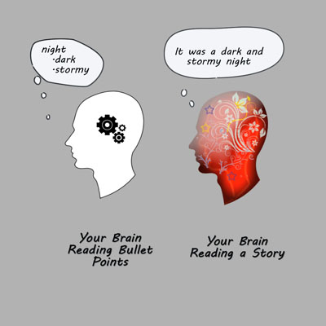
Use this slide only for layouts that would otherwise obscure the KDE logo
Notes:
6 minutes
Think of the last presentation you sat through (NOT RIGHT NOW LOL). What do you remember? The last story you were told? Lists, facts, and figures stimulate our brains as well – Broca’s areas – language processing where we decode words. Our brain says, “Yep, there’s new info.” Storytelling fires up a lot of regions depending on the story. Stories are cause and effect which is how we think. We use narrative all day to explain things. We want to relate to the story which is why metaphors work so well for us. We turn the story into our own experience. As an advertiser, as a teacher, sprinkle data related stories

Slide 18
Writing Narrative
The engaging shift
“I need to tell my audience something” to
“I have something to share”
Consider:
Apollo 13 directed by Ron Howard
NASA Report on Apollo 13
Notes:
1 minute

Slide 19
The Power of Story
Notes:
2 minutes

Slide 20
What it teaches us about storytelling
Notes:
3 minutes
How to closely read photographs, art, and film.
Mini task organizer how to read a video

Slide 21
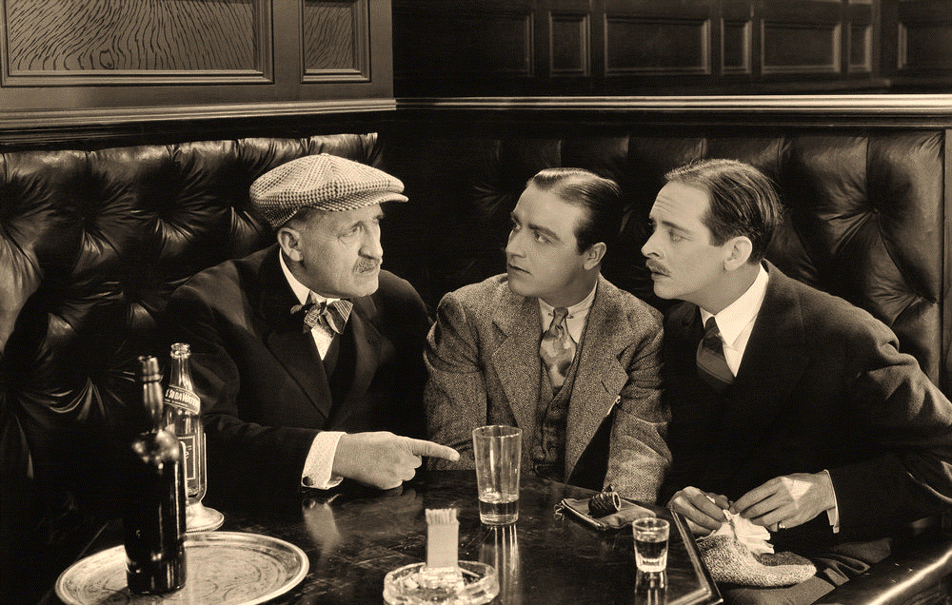
In our enlightened, literate, scientific world, it is still story structure that lies at the core of human mental functioning. “The reminds me of a story…” or “Once when the world was young…” are still the royal road to meaning and comprehension. Human minds are hard wired to think and perceive through stories.
Kendall Haven, Story Proof (2007)
Notes:
1 minute

Slide 22
Writing Task
After reading informational text, watching videos, and observing photographs of children facing poverty, write a vignette which captures a glimpse into a situation of a child you have taught.
Notes:
2 minutes

Slide 23
Vignette
A brief evocative description, account, or episode.
A small illustration or portrait photography that fades into the background without a definite border.
Notes:
This story fades without those borders. Ask participants to think about the theme(s) discussed and create a vignette. One of the most powerful things about this will probably be the fact that this is formative assessment. The students should know the exact target from the standard and understand what that means.

Slide 24
Notes:
Time: 10-15 minutes

Slide 25
3 Modes of Writing: Narrative
3 Levels of Text
Read the narrative portion of the 3 Modes Document
Highlight or underline the most important sentence, phrase, and word
Share with your table partners
Notes:
10 minutes

Slide 26
Writing Standard 3: Narrative
Write narratives to develop real or imagined experiences or events using effective technique, well-chosen details, and well-structured event sequences. (9-10 grade)
D
(9-10) Use precise words and phrases, telling details, and sensory language to convey a vivid picture of the experiences, events, setting, and/or character.
(5) Use concrete words and phrases and sensory details to convey experiences and events precisely.
Notes:
4 minutes
Ask a question using Plickers…”As an English teacher, I find ____ most difficult.”
Have them look at their narrative progression. Discuss this as formative assessment and assistance with grading. Discussion about feedback.

Slide 27
Narrative Progressions
Join others in your grade level.
Looking at writing standard 3 for your grade level, highlight/discuss key differences in the progressions from the grade before and the grade after yours.
Notes:
10 minutes

Slide 28
Writing Analysis
Switch your writing with a partner. Highlight and label areas where there is evidence of mastery of the standard.
List skills gaps from the evidence you see thus far.
As an entire grade level group, compare both mastery and gaps.
As a group, chart skills gaps you identified.
Notes:
20 minutes
Highlighting mastery and skills gaps. What we see as a gap can be targeted in the library.

Slide 29
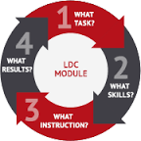
LDC Mini-Tasks: Media
Visual Analysis
Reading Photographs
Building Background Knowledge Through Photographs
Close Viewing Protocol
Film vs. Text
Media Circle Roles: Cinematographer
Notes:
1 minute

Slide 30
Core Tools
Log on to LDC.org
Top right hand corner, click on blue button “Core Tools Login”
Create a free account
Click on LDC Library
Notes:
20 minutes
Kelly will then take them through live the rest.

Slide 31
Break 10:30-10:45

Slide 32
Writing Standard 2: Informative/Explanatory
examine and convey
Notes:
Intro about the modes we will look at individuals and tie all 3 together, which is essential.

Slide 33
3 Modes of Writing: Informational
3 Levels of Text
Read the informational portion of the 3 Modes Document
Highlight or underline the most important sentence, phrase, and word
Share with your table partners
Notes:
10 minutes

Slide 34
Informational Progressions
Join others in your grade level.
Looking at writing standard 2 for your grade level, highlight/discuss key differences in the progressions from the grade before and the grade after yours.
Notes:
10 minutes

Slide 35
Informational Task
After reading and researching informational texts and websites about poverty, write an article which analyzes the impact of poverty on students’ learning. Be sure to support your discussion with evidence from the texts.
*link to the student story in your vignette
Notes:
2 minutes
A lens for collecting evidence.

Slide 36
200 Countries, 200 Years
Gapminder World
Notes:
Video 5 minutes + discussion 3 minute = 8 minutes
Take a small dive into Gapminder…it’s about beating ignorance for this organization. Take the 2 question Plicker quiz. They have sources to back it up. We a lot of times think and pass on bogus info because we were taught that and haven’t bothered to find out for sure or find out what’s changed.
We don’t have time to dedicate to participants exploring, but encourage and show what they can see.
Fake news, sources, inquiry, investigation, standards

Slide 37
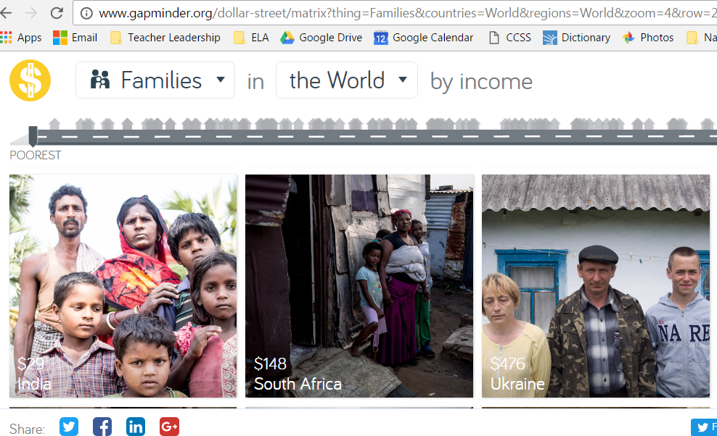
Dollar Street in Gapminder site
Notes:
7 minutes
This is another cool way to use gapminder. We may show them this when they are ready to gather some info.

Slide 38
Living in poverty, having so much bandwidth wrapped up in just making it from one day to the next, decreases a person’s cognitive function, making it harder to solve problems, resist impulses, and think long-term.
Notes:
10 minutes
Read text: examples Brenda Overturf article or “This is Your Brain on Poverty”

Slide 39
Writer’s Craft: Evidence

Slide 40
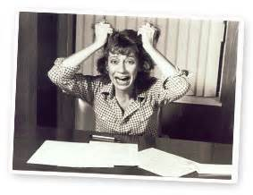
Be More Specific…
Knowing evidence is important…

Slide 41
Evidence=CSI
Notes:
When students think of evidence, most students think of CSI types of evidence. Analyzing how writer’s use evidence to develop and support their work will help student writers incorporate evidence into their own writing.

Slide 42
With Your Group…
Step 1: Take a moment to read the list of the 25 types of evidence writers commonly use.
Step 2: Highlight/underline evidence in “Interrupting the Cycle of Word Poverty”
Step 3: Label evidence as the appropriate type from the list of 25 (some may serve multiple purposes)
Step 4: Work through your Writer’s Craft Chart

Slide 43
Analyzing Writer’s Craft
Claim It! Quote from the Work | Name It! Label the Device/Technique | Frame It! Explain/Analyze Author’s Purpose
“According to the National Center for Children In Poverty,…”
“45% of children in the United States live in low-income households”

Slide 44
Find 3 More Examples of Evidence and Work Through Your Writer’s Craft Chart:
Notes:
Share resources and let participants practice writing text dependent questions for a text they plan to use in their module

Slide 45
Give One Get One
Everyone stand.
Take your Writer’s Craft: Evidence chart.
Meet with three people not at your table.
Give one piece of evidence that you found that they don’t have on their chart.
Get one piece of evidence from their chart and add to yours.
Notes:
Mini-Tasks: Writer’s Craft: Evidence, Give One Get One

Slide 46
Informational Task
After reading and researching informational texts and websites about poverty, write an article which analyzes the impact of poverty on students’ learning. Be sure to support your discussion with evidence from the texts.
*link to the student story in your vignette
Notes:
A lens for collecting evidence.

Slide 47
Writing Analysis
Switch your writing with a partner. Highlight and label areas where there is evidence of mastery of the standard.
List skills gaps from the evidence you see thus far.
As an entire grade level group, compare both mastery and gaps.
As a group, chart skills gaps you identified.
Notes:
Highlighting mastery and skills gaps. What we see as a gap can be targeted in the library.

Slide 48
LDC Mini-Tasks/CoreTools
Analyzing Writer’s Craft: Evidence
Give One Get One
Analyzing Infographics
Practice Using Infographics as Evidence
Textual Evidence Swap Meet

Slide 49
LUNCH 12:00-1:00

Slide 50
Writing Standard 1: Argument (6-12) Opinion (K-5)
examine and convey
Notes:
Intro about the modes we will look at individuals and tie all 3 together, which is essential.

Slide 51
3 Modes of Writing: Argument
3 Levels of Text
Read the informational portion of the 3 Modes Document
Highlight or underline the most important sentence, phrase, and word
Share with your table partners
Notes:
7 minutes

Slide 52
Argument Progressions
Join others in your grade level.
Looking at writing standard 1 for your grade level, highlight/discuss key differences in the progressions from the grade before and the grade after yours.

Slide 53
Argument Task
After reading and researching informational texts and websites about poverty, write an editorial in which you argue whether or not poverty determines the potential of student success.
Notes:
Beating the Odds Articles
http://www.huffingtonpost.com/marian-wright-edelman/shining-like-a-diamond_b_6124060.html
http://www.huffingtonpost.com/news/beat-the-odds/
YouTube Children’s Defense Fund (Beating the Odds videos)

Slide 54
Poverty Myths Debunked
Find a slip of paper on your table for each person.
Find someone else in the room with that same number.
One of you has a myth, the other has the fact.
Notes:
8 minutes

Slide 55
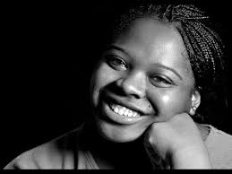
Beating the Odds: Britiny Lee
Continue with pros/cons organizer
Notes:
Continue with Pros/Cons Organizer
https://www.youtube.com/watch?v=Zf4D5SBjHBk&t=9s

Slide 56
CLAIM = A position that can be argued. Strong claims are compelling, debatable and defensible.
What is the difference between a claim and a fact?
Can be supported with recent reliable evidence
Evokes interest
Because it’s not a fact.
Notes:
A handout with more information about claims is available at the Purdue University Online Writing Lab (OWL)
https://owl.english.purdue.edu/owl/resource/588/01/.

Slide 57
Strong claims are compelling, debatable and defensible.
Other Key Characteristics of a Strong Claim:
Identifies the writer’s stance (position)
Is clear and specific (shows the direction of the writer’s thinking)
May use an “umbrella” term that relates to the major points to be made instead of listing all of your evidence
Avoids terms such as “I think” or “I feel”

Slide 58
3 Major Types of CLAIMS | Sample Key Words | Example
FACT (writer is trying to prove something is true) | IS or IS NOT ARE or ARE NOT | Fast Food is unhealthy.
VALUE (requires writer to share or establish criteria) | BETTER/BEST, MORE/LESS, WORSE/WORST --IER or IEST words | Tacos are a healthier choice than hamburgers.
POLICY (writer is trying to change the way things are) | SHOULD/SHOULD NOT | Schools should serve healthier foods.
Notes:
These are not the only types of claims, but are ones that seem to be the easiest for students to work with. Others include cause-effect (writer tries to prove a relationship, answering questions such as “What caused X? What are the effects?) and definition (“What is X? How should we define it?). Problem-Solution is essentially the same as an argument of policy.

Slide 59
Are These Good Claims?
In most states,
teens can drive
at 16.
Kentucky should raise the driving age to 18.
No! This is a statement of fact.
Yes! This is a compelling, debatable, defensible claim.

Slide 60
Making Claims STRONGER
Instead of… | Try…
I think Reality TV is good. Why? We can’t argue against this statement. It is a fact that you like it. | The popularity of Reality TV proves that it meets the audience’s needs.
Reality TV is fake. Why? This is a common complaint and flunks the “compelling” requirement. So what? | Because Reality TV is fake, its lessons are not always “real.” We should therefore limit children’s exposure to it.
You won’t catch me watching Reality TV because of stereotyping. Why? Great angle, but so what? Go beyond yourself to make this debatable! | Viewers should avoid Reality TV because it promotes stereotyping.

Slide 61
Argument Highway: A Metaphor
Says—Means—Matters--Countering

Slide 62
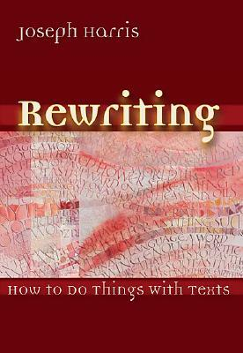
Argument Highway
An instructional metaphor based on
Rewriting: How to Do Things with Texts
by Joseph Harris

Slide 63
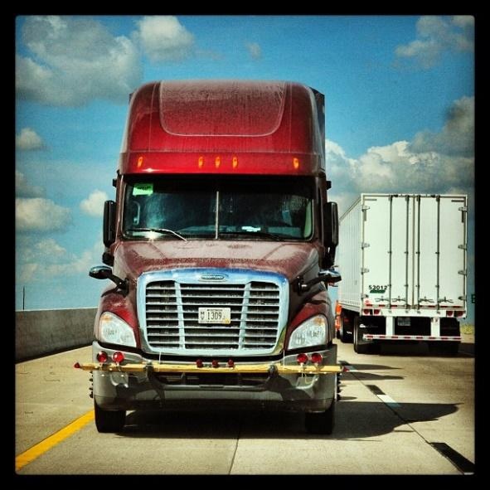
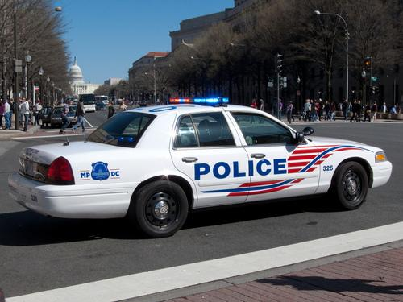
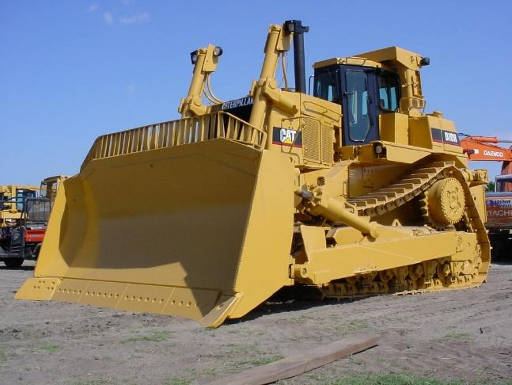
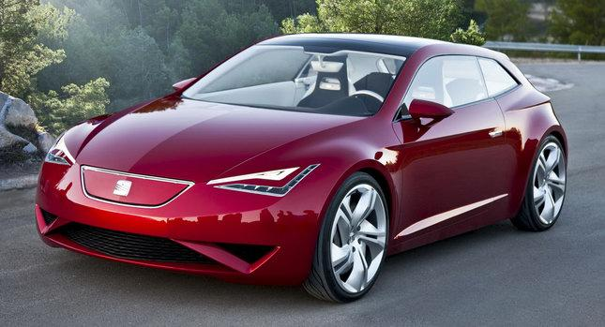
Terms to Know: The Vehicles
The vehicles represent the ways students quote and use source material – the deliberate and specific moves writers make to forward and counter texts.

Slide 64
The Vehicles (Forwarding Moves)
Authorizing
Extending
Illustrating

Slide 65
The Vehicles (Countering Moves)
“The aim of countering is to open up new lines of inquiry.”
–Harris in Rewriting: How to Do Things with Texts
All forms of Countering
(Arguing the Other Side, Uncovering Values, Dissenting)

Slide 66
Forwarding Moves
Illustrating – When students use specific examples from the text to support what they want to say.
The 18-wheeler carries lots of cargo, representing “material to think about: anecdotes, images, scenarios, data.” (Harris)

Slide 67
What Illustrating Looks Like
Language that captures what an author is saying/doing, as in these templates from Graff and Birkenstein’s They Say I Say:
X argues that
X claims that
X acknowledges that
X emphasizes that
X tells the story of
X reports that
X believes that

Slide 68
Forwarding Moves
Authorizing – When students quote an expert or use the credibility or status of a source to support their claims.

Slide 69
What Authorizing Looks Like
Language that names the particular expertise, credibility, and/or status of an author or source, as in these examples:
Joseph Bauxbaum, a researcher at the Mount Sinai School of Medicine, found …
… , according to Susan Smith, principal of a school which encourages student cell phone use, …
A study conducted by the Gulf Coast Center for Law & Policy Center revealed that …

Slide 70
Forwarding Moves
Extending – When students put their own “spin” on terms and ideas they take from other texts.

Slide 71
What Extending Looks Like
Language that reframes the text, adds another layer of interpretation, and/or drives it forward to new conclusions:
So now the latest victims of the Fear of Missing Out are the executives at Facebook themselves, whose dwindling market share is a result of greed and the failure to respond to the demands of a wired generation.

Slide 72
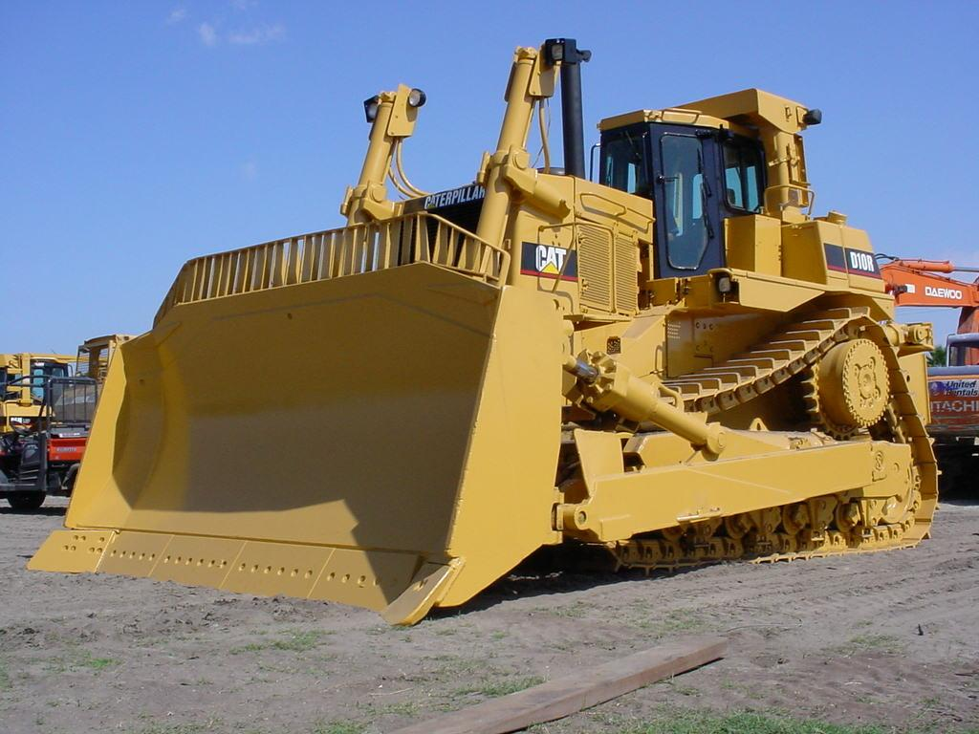
Countering Moves
When students “push back” against the text in some way. They might disagree with it, challenge something it says, or interpret it differently than the author does.

Slide 73
What Countering Looks Like
Language that takes another approach, identifies hidden or absent arguments, or explains where an argument falls short.
What the author fails to consider is … This is true, but …
The same thing can be said for …
The author doesn’t explain why ….
Another way to look at this is …
The study doesn’t explore the connections between …

Slide 74
Works Cited
Harris, Joseph. Rewriting: How to Do Things with Texts. Utah: Utah
State University Press, 2006. Print.
Graff, Gerald and Cathy Birkinstein. They Say I Say: The Moves that
Matter in Academic Writing. 2nd ed. New York: W.W. Norton &
Company, 2009. Print.

Slide 75
Transition to Writing: Socratic Seminar

Slide 76
Skill: Transition to Writing Mini-task: Socratic Seminar
https://www.teachingchannel.org/videos/teaching-the-n-word
Viewing lens: Structure of Socratic Seminar

Slide 77
Socratic Seminar:
Notes:
Share resources and let participants practice writing text dependent questions for a text they plan to use in their module

Slide 78
Socratic Seminar: Expectations
We read and think about the text in advance.
We refer to the text and give enough time for fellow classmates to locate text.
We engage in conversation; we don’t talk at each other.
We show we are listening by tracking the speaker and summarizing what a classmate said.
We don’t raise our hand, but we wait for speaker to finish.
We ask questions, give comments, but always give evidence to support our opinions.

Slide 79
Socratic Seminar
It’s OKAY to disagree, so long as you do so respectfully
I understand what you are saying, but I disagree because…
I respect your opinion, but I disagree because…
I hear where you are coming from, but…
Most importantly, in a discussion there are no right or wrong answers.
Notes:
Take notes throughout

Slide 80
Sentence Starters
So what you’re saying is…
I disagree/agree…
I’d like to raise a question…
I’m confused about…
What is your opinion of…
I think this means…
What puzzles me is…
This relates to…
Do you agree/disagree….
Don’t you think this is similar to…
I’d like to talk with people about…

Slide 81
Follow-Up Questions
Tell me more about that.
What about the reading made you think that ___?
Using evidence, convince us that __.
In what other context does that idea play out?
What evidence would you give to someone who thought ___?
Based on what we have read, what do you think that we will discover in the next chapter?
After reading this information, how would handle a situation like ___?
How is your answer different or the same from others?
So, this leads to you to what conclusions?
What did you discover?
Adapted from http://www.edutopia.org/blog/rethinking-whole-class-discussion-todd-finley

Slide 82
Readying for a Socratic Seminar
Reviewing notes
Reviewing roles
Setting a goal

Slide 83
LDC Mini-Tasks
Socratic Seminar
Linking Claims and Evidence with Analysis
Citing Evidence for Claims
Claims, Data, and Analysis
Plausible Counterclaims
Tug for Truth

Slide 84
Resources
Addressing Three Modes of Writing in the 21st Century (KDE)
10 Poverty Myths Busted
The Learning Network Picture of the Day
NCTE: Professional Knowledge for the Teaching of Writing (2016)
The Neuroscience of Storytelling
Your Brain on Story: Why Narratives Win Our Hearts and Minds

Slide 85
Use this slide only for layouts that would otherwise obscure the KDE logo or blue background elements

